Slide 1
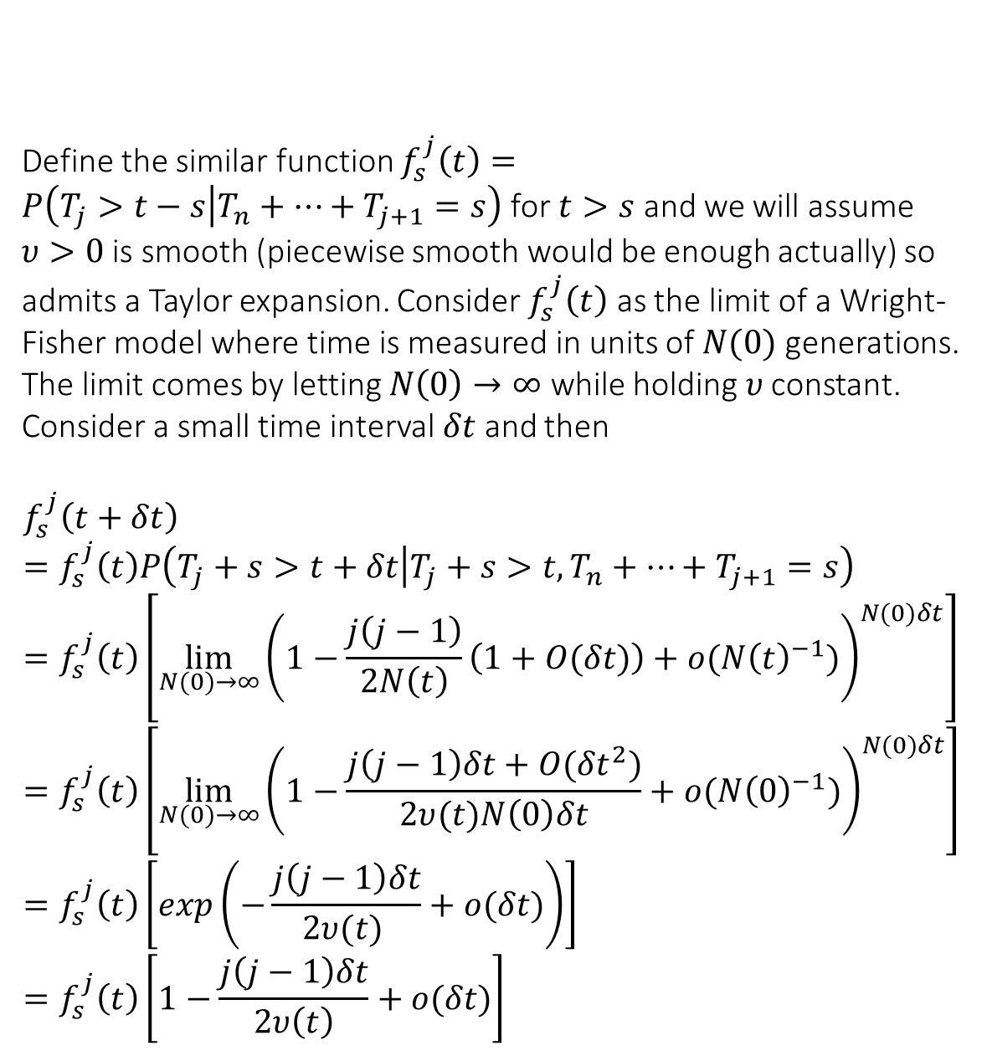
Variable size populations proof
Define the similar function $f_{s}^{j}\left(t\right)=P\left(T_{j}>t−s | T_{n}+…+T_{j+1}=s\right)$ for $t>s$ and we will assume $υ>0$ is smooth (piecewise smooth would be enough actually) so admits a Taylor expansion. Consider $f_{s}^{j}\left(t\right)$ as the limit of a Wright-Fisher model where time is measured in units of $N(0)$ generations. The limit comes by letting $N\left(0\right)→∞$ while holding$υ$ constant. Consider a small time interval $δt$ and then
$$f_{s}^{j}\left(t+δt\right)=f_{s}^{j}\left(t\right)P\left(T_{j}+s>t+δt | T_{j}+s>t,T_{n}+…+T_{j+1}=s\right) \\ =f_{s}^{j}\left(t\right)\left[\lim_{N(0)→∞}{{\left(1−\frac{j\left(j−1\right)}{2N\left(t\right)}\left(1+O(δt)\right)+o({N\left(t\right)}^{−1})\right)}^{N(0)δt}}\right] \\ =f_{s}^{j}\left(t\right)\left[\lim_{N(0)→∞}{{\left(1−\frac{j\left(j−1\right)δt+O({δt}^{2})}{2υ(t)N\left(0\right)δt}+o({N\left(0\right)}^{−1})\right)}^{N(0)δt}}\right] \\ =f_{s}^{j}\left(t\right)\left[exp\left(−\frac{j\left(j−1\right)δt}{2υ(t) }+o(δt)\right)\right] \\ =f_{s}^{j}\left(t\right)\left[1−\frac{j\left(j−1\right)δt}{2υ\left(t\right)}+o(δt)\right]$$

Slide 2
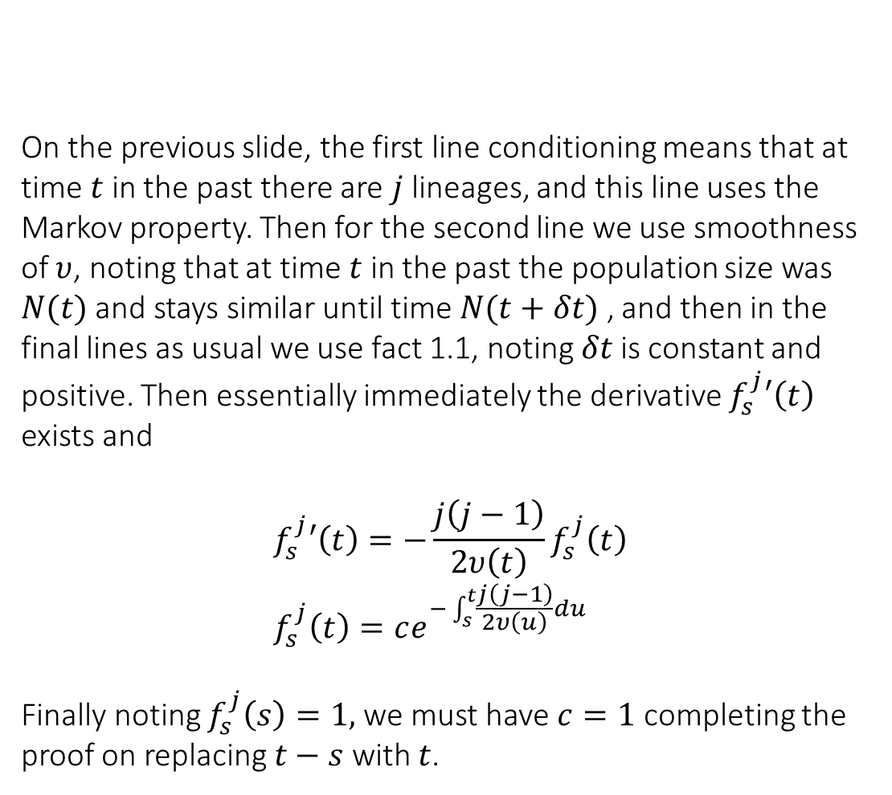
Variable size populations proof
On the previous slide, the first line conditioning means that at time $t$ in the past there are $j$ lineages, and this line uses the Markov property. Then for the second line we use smoothness of $υ$, noting that at time $t$ in the past the population size was $N(t)$ and stays similar until time $N(t+δt)$ , and then in the final lines as usual we use fact 1.1, noting $δt$is constant and positive. Then essentially immediately the derivative $f_{s}^{j}′\left(t\right)$ exists and
$$f_{s}^{j}′\left(t\right)=−\frac{j\left(j−1\right)}{2υ\left(t\right)}f_{s}^{j}\left(t\right) \\ f_{s}^{j}\left(t\right)=ce^{−\int_{s}^{t}{\frac{j\left(j−1\right)}{2υ\left(u\right)}du}}$$
Finally noting $f_{s}^{j}\left(s\right)=1,$we must have $c=1$ completing the proof on replacing $t−s$ with $t$.
(2.3.1)

