Slide 1
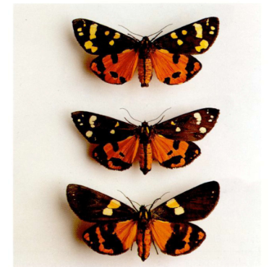
5.0 Natural selection
As we have seen from the recombination section, many organisms are diploid
In the Tiger moth population, at a particular position in the genome there are two alleles, A and a.
Individuals who carry AA, Aa, aa give the three colour morphs above.(dominula, medionigra, and bimacula)

Slide 2
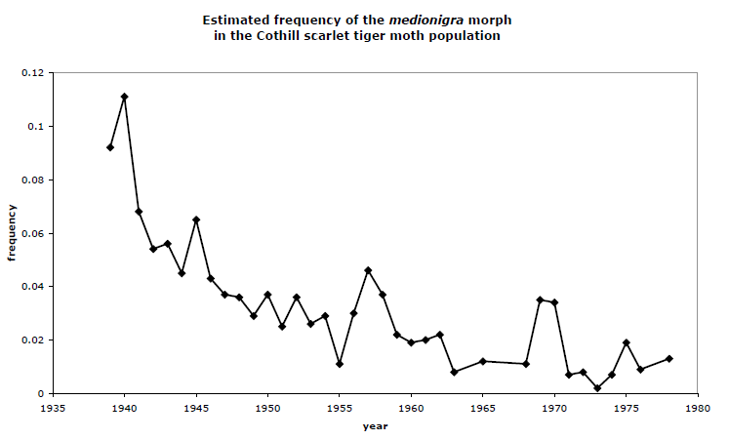
5.0 Natural selection
The plot above (O’Hara, 2005) shows the frequency of the medionigra morph through time
This mutant form gets progressively rarer – why?
Suggests selection against medionigra morph – i.e. this morph is disadvantageous.
Why does the decline fluctuate? What is the role of chance?
To see how to answer these questions in general, we need a model of selection in the Wright-Fisher model.

Slide 3
5.1 Selection in the Wright-Fisher model
As usual: discrete gens, generation k+1 is formed by randomly sampling parents in generation k, constant population size 2N
There are two types in the population, A (n copies) and a (2N-n copies) and no further mutation
Parents are not chosen uniformly at random Each individual independently chooses each A parent with probability proportional to (1+s), and each a parent with probability proportional to 1.
We say the fitness of A is (1+s) and the fitness of a is 1
A
a
Gen. k
Relative prob 1+s
Gen. k+1
Relative prob 1

Slide 4
5.1 Selection in the Wright-Fisher model
We consider the changing future frequency of the mutation A in the population.
After k gens, define Z_{k} to be the A allele count, and define X_{k}= Z_{k}/2N to be the frequency of the A allele
Suppose Z₀=n (a new definition of n!)
A has initial frequency X₀= x=n/2N, a has frequency 1-x
For every chromosome in generation k+1, independently:
As the population size is 2N, given X_{k}:
This is all we need to simulate selection
Z₀=n
X₀=x=n/2N

Slide 5
5.1 Selection in the Wright-Fisher model
s=0 corresponds to no selection – neutrality. Parents are chosen at random, giving the Wright-Fisher model you have seen before.
s>0 corresponds to positive or advantageous selection for the A allele
s<0 corresponds to negative or deleterious selection for the A allele
Note that the selection is on a single allele – in diploid organisms (2 copies of each chromosome), this is still a valid model, called genic selection.
Other, more complex selection models are possible. Problem sheet has an example.

Slide 6
Questions
We can ask many questions but will focus on the following fundamental ones:
We say a mutation fixes in the population if its allele frequency eventually becomes 1.
For a given selective strength, what is the probability of a mutation ultimately fixing in the population?
What is the effect of s, and the population size 2N?
What happens if s is negative?
How can we detect selection in practice?
Note these can be answered by thinking forward in time
We need a new way to model mutations. We rescale time in units of 2N generations, and model X_{t} using a diffusion
As usual, our results are more general than W-F models. We only touch on the theory!

Slide 7
5.1 Realisations of W-F with selection
N=10,000, s=0.0
N=10,000, s=0.001

Slide 8
5.1 Realisations of W-F with selection
N=1,000, s=0.001
N=100, s=0.001

Slide 9
5.2 Looking for a limit process
Simulation offers little insight into results gained and gives results specific to this precise model
Selection difficult to consider exactly
Analogously to the coalescent backward in time, forward in time we:
  Consider the behaviour for a single generation
  Multiply parameters by population size (as we did for θ=4Nμ)
  Rescale time in units of population size 2N
  Let N→∞ to get a limit process
This limit process is called a diffusion
As in the coalescent, the same limit arises for diverse models, including continuous time models

Slide 10
5.3 Finding a W-F limiting process
Suppose at some time point (say T) our current A allele frequency is X_{T}=x.
Notice that since generations are independent, future behaviour depends only on this fact, not on previous generations – this is the Markov property.
Hence, we can characterise the whole process by considering what happens in a short time, i.e. one generation.
We will consider the mean and mean square, and bound the higher moments, of X_{T+1}-x (the freq. jump in one gen.)
This turns out to be enough. Note the A allele count Z_{T+1}~Binom(2N,p_{T}) and X_{T+1} = Z_{T+1} /2N.
We can use this to understand the behaviour for small s. We rescale and set γ=2Ns. We think of γ as staying constant while N→∞.

Slide 11
5.3 Finding a W-F limiting process
Using the binomial distribution for Z_{T+1}, we find easily:
Note: change in frequency in one generation is order 1/2N

Slide 12
5.5 The W-F limiting process
We seek a continuous time limit process; we measure time in units of generations.
Define t=T/2N to be rescaled time. Define a (speeded up) process
To think about a continuous time limit process, define δt=1/2N, the smallest time jump possible for finite N.
Conditional on Y_{t}=x, we can write down the following from the previous slide:
Note: N no longer appears, so after the double rescaling of s and time, changes over time δt depend only on δt. Hence we may hope a continuous time (Markovian) limit process exists as N→∞.
Higher order cumulants are almost 0 for large N. Thus, the change in allele frequency over time δt has an approximate normal distribution

Slide 13
5.6 Example: effect of rescaling on W-F model
2N=20000
2N=2000
Different N values
and γ= 5
This suggests a limit process does exist.
In fact, this is true and our proving equations 5.7.1 is sufficient to guarantee convergence to a diffusion process limit
Proof beyond our scope! We give a taste of the subject
2N=200

Slide 14
5.7 Diffusion processes
We start with the canonical example of a diffusion process, called Brownian motion.
Intuitively, this is a continuous time process which has normal “jumps”
We will assume the (true) fact that the following results in a well-defined process.
Definition 5.12 Brownian motion. The real valued stochastic process B(t)=B_{t}, t≥0 is a Brownian motion if
For each t>0 and s ≥0, B(t+s)-B(s) has the normal distribution with mean 0 and variance σ²t for some constant σ.
For any n ≥1 and 0≤t₁ ≤t₂… ≤t_{n}, the random variables
are mutually independent for r=2,3,...,n
B(0)=0
B(t) is continuous in t≥0
Brownian motion realisation
B(0)=0
Easy to restrict to a given domain [a,b] e.g. [-10,10]

Slide 15
5.8 Diffusion interpretation
First note that by properties 1. and 2., Brownian motion is a Markov process.
Consider the movement of Brownian motion over a small time δt, conditional on B_{t}=x:
This is reminiscent of what we derived for the W-F model previously (equation 5.5.1) and is an alternative characterisation
Suppose we take any smooth b(x) and a(x)>0. Informally, make a new process X_{t} so that over small time δt:
Now, we let δt→0 and again rely on (assume) the fact this gives a well-defined process.

Slide 16
5.9 Definition: Diffusion process
A one-dimensional time-homogenous diffusion process X_{t} is a continuous time Markov process such that there exist two functions a(x) and b(x) satisfying the following properties given X_{t}=x, where :
for any k≥3.
Notes and definitions:
b(x) is called the infinitesimal mean or drift parameter
a(x)>0 is called the infinitesimal variance or diffusion parameter
A unique diffusion process with infinitesimal mean and variance a(x) and b(x) is guaranteed to exist if these functions are smooth
The third property is required for continuity
Conversely, if these three conditions are satisfied for a given continuous time Markov process X_{t} ,and a(x) and b(x) are smooth, then X_{t} is a time-homogenous diffusion process with this infinitesimal mean and variance
E.g. Brownian motion has b(x)≡0, a(x)=σ²

Slide 17
5.10 The Wright-Fisher diffusion process
If Y_{t} is the population frequency of the selected allele A at time t, given Y_{t}=x, δt=1/2N we showed, taking E=[0,1], (5.5.1):
for any k≥3, where
a(x)=x(1-x), the diffusion parameter (infinitesimal variance)
b(x)=γx(1-x), the drift parameter (infinitesimal mean)
It can be shown that these three conditions, with a(x) and b(x) smooth, guarantees convergence in distribution of Y_{t} in the limit as N→∞ to a diffusion process, for all t>0. Abuse notation and (for simplicity) label this process Y_{t} also. This is the Wright-Fisher diffusion with selection.

Slide 18
5.10 The Wright-Fisher diffusion limit
Remarks:
How the process moves depends on where we are, i.e. x
The product γ =2Ns determines the behaviour
Beneficial alleles tend to become more frequent in the population, deleterious alleles rarer
Genetic drift can play a role. Genetic drift is stochastic variation in allele frequencies through time, captured by the infinitesimal variance. NB: Genetic drift is not to be confused with the unfortunately very similarly named infinitesimal drift
Selection is stronger - more effective - in larger populations
Other models of selection, and models including mutation, have different infinitesimal mean, and (often) the same infinitesimal variance (independent of γ here).

Slide 19
6.1 A diffusion process characterisation
The infinitesimal mean and variance directly relate to the behaviour of the process in a small time.
However, there is a neater description of a diffusion process that is also powerful, and useful for calculations.
Consider an arbitrary function f whose domain is that of the diffusion. In all our examples, f:[0,1] →R.
Suppose for now that f is at least be three times continuously differentiable. How does f(X_{t} ) evolve?
We obtain the derivative of its expectation with respect to time.

Slide 20
6.1 An alternative diffusion process characterisation
X_{t}
f(x)=2x(1-x); f(X_{t})
Expectation of f(X_{t}) (500 diffusion realisations)

Slide 21
6.1 A diffusion process characterisation
How does E[f(X_{t} )] evolve, for arbitrary f?
If the diffusion is currently at state x, assume wlog the current time is 0, then consider the expectation of f(X_{δt} ) at time δt. Taylor expanding, for some x’ between x and X_{δt}:

Slide 22
6.1 A diffusion process characterisation
Rearranging and taking limits:
This is a vital equation for any diffusion process, because it tells us how the expectation of an arbitrary function changes through time, as a function of current position.
It is in a powerful sense a generating function for a diffusion process, and so is called the generator

Slide 23
6.2 The generator of a diffusion
Definition 6.2. Generator. The generator L of a time-homogeneous diffusion process is defined as the operator L on function space, where for a function
f: R →R
The domain D(L) is the set of all functions f for which the right hand side is well defined.
The generator actually makes sense for any “time-homogeneous” Markov process
The generator maps functions to functions, so is an operator (on a “big” space of functions)
The generator completely defines a Markov process

Slide 24
6.2 The generator of a diffusion process
Given our previous derivation, we can use this idea to more succinctly define a diffusion process, in terms of its generator:
Definition 6.3, Diffusion process. A time-homogeneous diffusion process is a continuous time Markov process with generator:
b(x) is the infinitesimal mean, and a(x) the infinitesimal variance, of the diffusion, and D(L)=C² _{c}(R)
Notes:
It can be shown that the generator uniquely defines the diffusion process.
In particular, using f(y)=(y-x)^{k} k=1,2,...reconstructs the diffusion definition in terms of the infinitesimal mean, variance, and higher moment description we earlier gave (Exercise)
More generally, choosing f carefully, we can learn interesting features of the diffusion.
We will see this idea powerfully for fixation probabilities

Slide 25
6.3 Examples of generators
In our Wright-Fisher diffusion with selection, we have
a(x)=x(1-x), the diffusion parameter (infinitesimal variance)
b(x)=γx(1-x), the drift parameter (infinitesimal mean)
Thus, the generator is
For the Brownian motion case:
a(x)=σ², b(x)=0
Next, we will see how to use the generator to see how likely a selected mutation is to become fixed from frequency x.

Slide 26
6.3.1 Example ctd: Wright-Fisher diffusion with selection
The generator is
We started off by thinking of an example function:
So if x=0.1, γ=5, then
Can we learn deeper properties using the generator?

Slide 27
6.1 An alternative diffusion process characterisation
X_{t}
f(X_{t})=2x(1-x)
Expectation of f(X_{t}) (500 diffusion realisations)
0.54

Slide 28
7.1 Calculating the probability of loss or fixation
γ=2, Initial frequency 10%
2 of these 10 Wright-Fisher
diffusions reach fixation
What is the probability in general?

Slide 29
7.1 Calculating the probability of loss or fixation
IDEA: The Wright-Fisher model we have derived incorporates no mutation (so approximates the infinite-sites model).
Without mutation, eventually the mutation is either lost (reaches frequency 0) or fixes (reaches frequency 1) in the population.
What are the boundary hitting probabilities of these events?
We will start by considering the general diffusion process case.
The generator can often be calculated explicitly, and thus used to obtain differential equations for quantities of interest – this is one such case

Slide 30
7.2 Boundary hitting probabilities
Consider a general diffusion process on an interval [l,r] (in our setting, a subset of [0,1])
l and r are absorbing boundaries: if the diffusion hits either, it remains there
  Suppose we just want to ask if any diffusion hits l or r first, starting from x, where l<x<r
  We simply impose this condition – this is called stopping the diffusion, if it hits l or r.
  Calculations unchanged
Suppose the following facts hold:
  The process begins at x, l<x<r
  With probability 1, the time τ when the process hits l or r is finite
Note that as diffusions are continuous, X_{τ}=l or r
Define

Slide 31
7.3 Boundary hitting probabilities in a general diffusion
Note that the expectation of h is constant:
Rearranging:

Slide 32
7.3 Boundary hitting probabilities in a general diffusion
N.B. We have expressed the required probability in terms of the generator
Note we don’t need to know when the process hits the boundary
This is a differential equation:
We can solve this second order equation, with two boundary conditions, to find a unique solution.

Slide 33
7.3 Boundary hitting probabilities in a general diffusion
Now use the boundary conditions to obtain A, C:

Slide 34
7.3 Boundary hitting probabilities in a general diffusion
Note that this solution is only valid under the assumption that the diffusion is guaranteed to eventually reach an absorbing boundary
This is true for Wright-Fisher diffusions without mutation, but not true in general when mutation can occur (Exercise sheet).

Slide 35
7.4 Fixation probabilities in the Wright-Fisher model with selection
Substitute in a(z)=z(1-z), b(z)=γz(1-z) to give that for an initial frequency x, and γ≠0 :
If γ=0 (or for the general case b≡0)
(7.4.1)

Slide 36
7.4 Fixation in the Wright-Fisher model with selection
This is a fundamental equation in population genetics and we can discuss implications
Unsurprisingly, the fixation probability increases with x and γ
Note that even for large positive γ, it is very small for newly arising mutations
For negative γ, fixation can still occur

Slide 37
7.5 Newly arising alleles in the Wright-Fisher model
One focus of interest is: what is the probability a newly arising allele in the Wright-Fisher model fixes in the population?
This is called the substitution probability
The rate at which mutations arise and fix in the population is the substitution rate
Mutations arise as a single copy, i.e. frequency x=1/2N, in the population
The fixation probability of such newly arising mutations converges, as N→∞ to
This can be rigorously shown, but is technically involved
We consider some possible cases

Slide 38
7.5 Newly arising alleles in the Wright-Fisher model
from (7.4.1)
If the allele is beneficial s>0, and 2Ns>>1, s<<1
so the fixation probability is twice the selection coefficient
If the allele is nearly neutral, and |2Ns|<<1,
so the fixation probability is close to the neutral case 1/2N.

Slide 39
7.5 Newly arising alleles in the Wright-Fisher model
If the allele is deleterious: s<0, and |2Ns|>>1, |s|<<1
so the fixation probability declines exponentially with population size
Large populations are extremely effective at preventing the fixation of mutations that have a negative effect on organisms
In smaller populations, random genetic drift can allow such deleterious mutations to fix

Slide 40
7.5 Newly arising alleles in the Wright-Fisher model
To summarise:
Most newly arising beneficial alleles are destined to be lost from even large populations, but in large populations many beneficial mutations can arise
Roughly, (positive or negatively selected) alleles behave neutrally unless the selection coefficient is larger than the reciprocal of twice the population size, |s|>1/2N
This condition can often be met in cases where selection is almost impossible to measure directly (e.g. N≈10,000 in humans, N>1,000,000 in fruit flies!)
Deleterious mutations are much more likely to fix in smaller populations
Overall, selection works much more effectively in larger populations

Slide 41
7.6 The substitution rate
If we follow a species through time, how fast is it expected to evolve?
The answer depends on the population size N and strength s of selection
It also depends on the mutation rate
The predicted value of s depends on the type of sequence we are looking at
  Some mutations will disrupt the “code” for a gene – these are called “non-synonymous” mutations and can be identified from DNA sequence. We expect s<0 for most such cases
  Other mutations will either occur outside any genes (non-genic mutations), or do not disrupt the product – called a protein – the gene codes for: “synonymous” mutations. Here, we expect s≈0.
Non-coding, 98.5%
Genic, coding, 1.5%

Slide 42
7.7 Estimating the substitution rate
  Suppose we are willing to assume mutation is rare enough within a region that mutations arise and are lost, or fix, in the population one at a time
  If so, new mutations arise in our population at rate 2Nμ, so the fixation rate (number of new mutations that eventually fix per generation) is:
  From section 7.5 this gives estimated substitution rates, which can be used to find real selection signals
Deleterious
Nearly neutral
(no dependence on N)
Advantageous

Slide 43
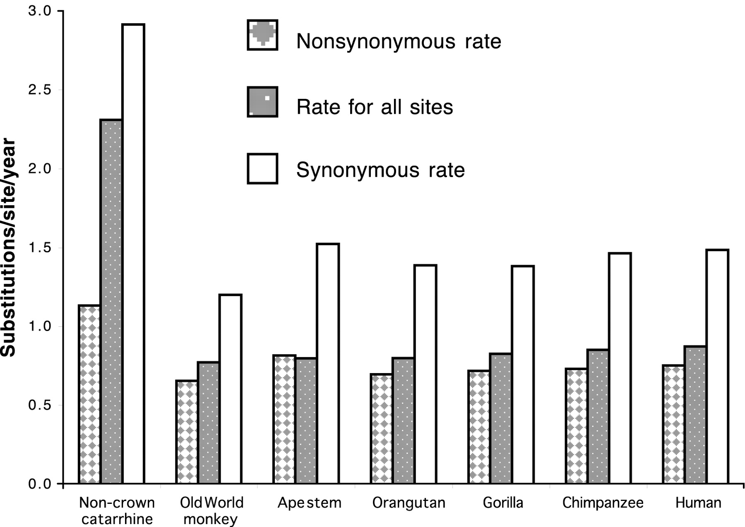
7.7 Non-synonymous versus synonymous substitutions
Data from Wildman, Uddin et al., PNAS (2003)
Each set of three bars shows the estimated substitution rate scaled by 10⁻⁹ for a single branch of the primate “tree of life”.
Non-synonymous (NS) mutations have a far lower substitution rate than synonymous (S) mutations
The NS:S substitution rate ratio is <5% in Drosophila (Dunn, Bielawski and Yang Genetics 2001.) Drosophila have very large population sizes, so selection is extremely effective.

