Slide 1
Stochastic models in Mathematical Genetics
(SC1/ SM11)
Simon Myers
All lecture materials are available via Canvas
Questions, use Canvas or email myers@stats.ox.ac.uk
Also, course webpage:
www.stats.ox.ac.uk/~myers/mathgen.html
Class problem sheets are posted online (separate sheets for MSc and Part C)
Solutions posted (after any class)
Notes online; lectures appear online

Slide 2

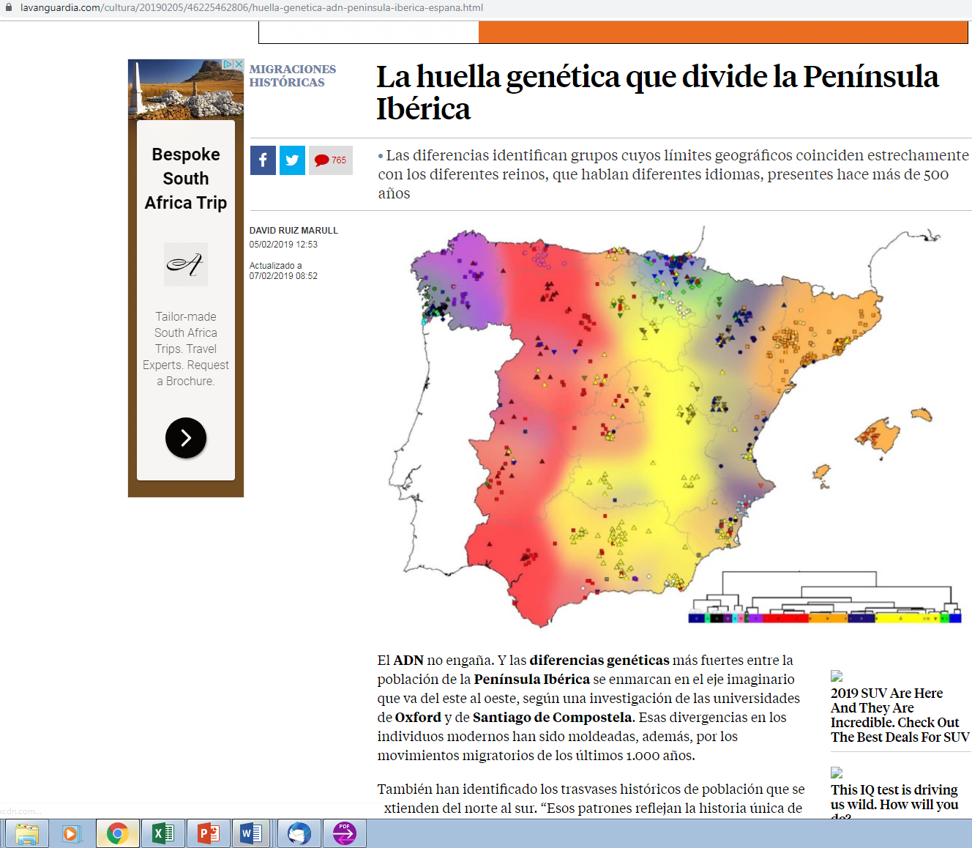
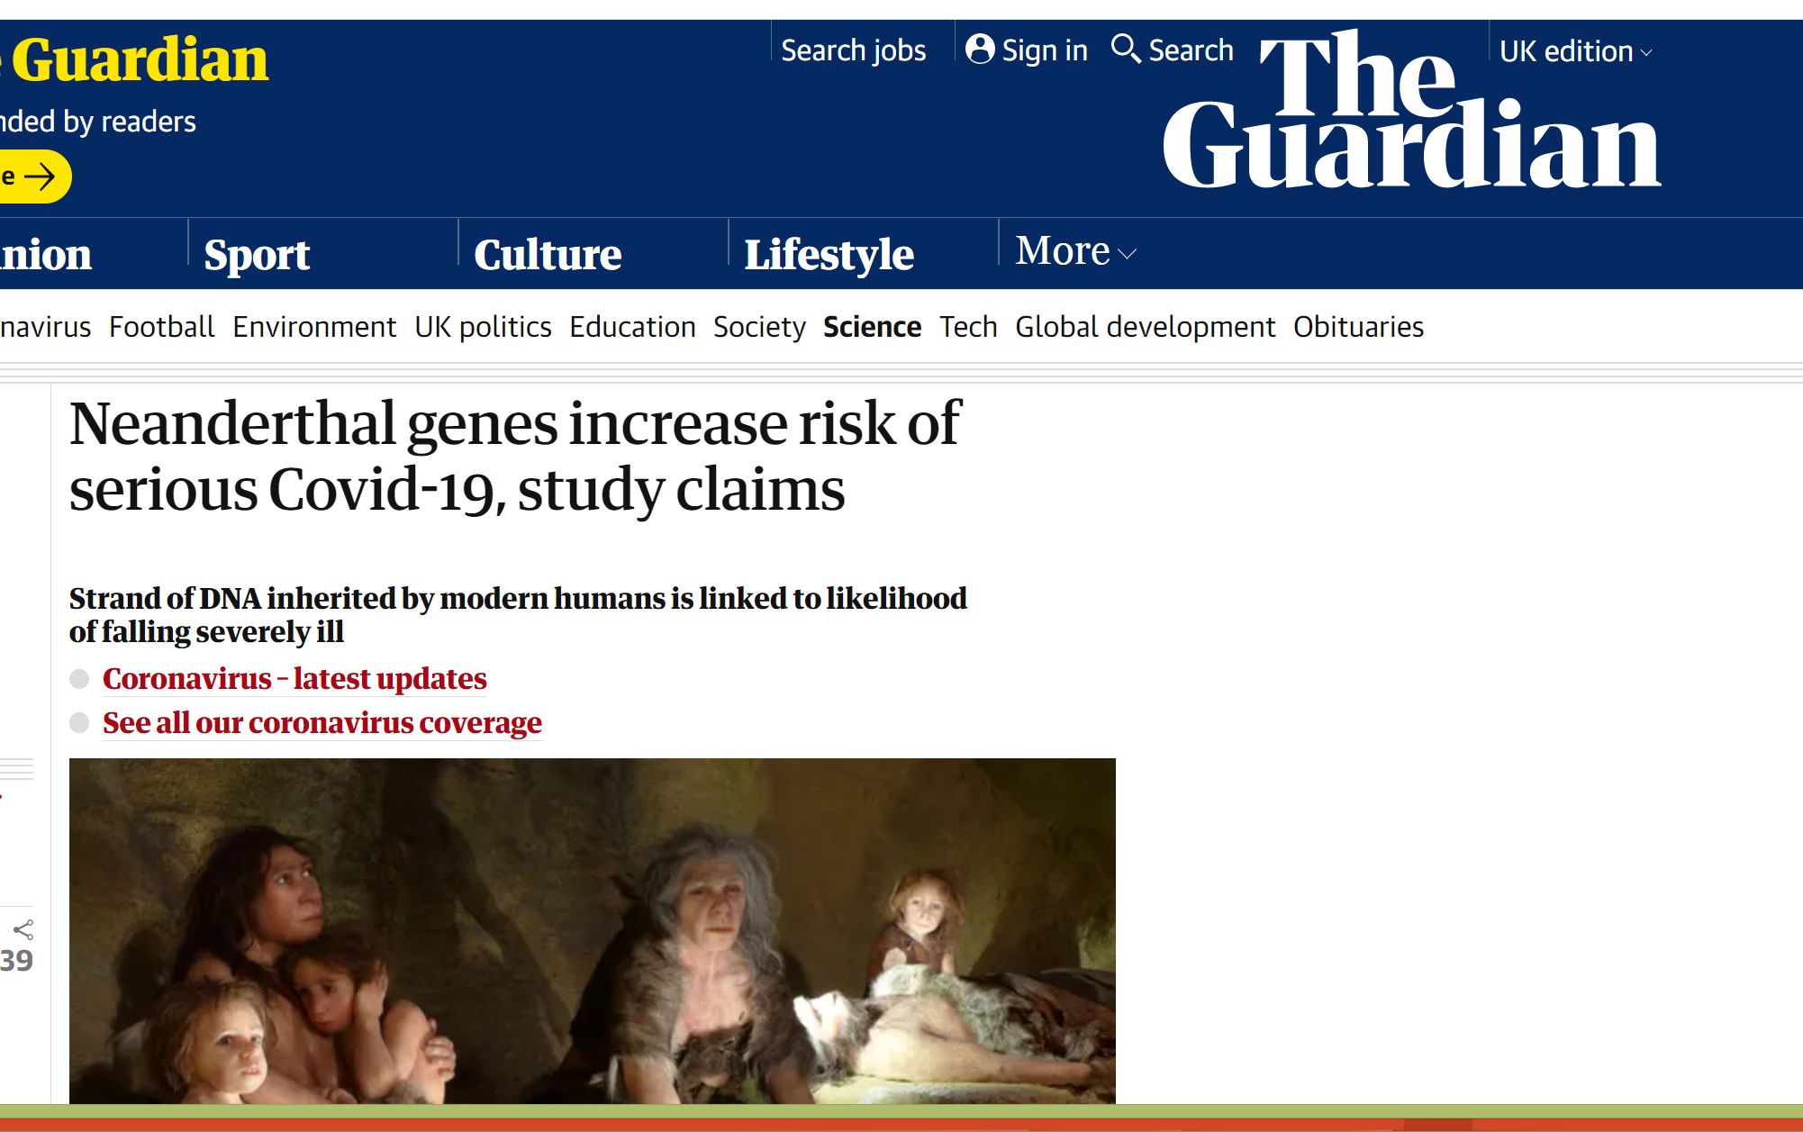


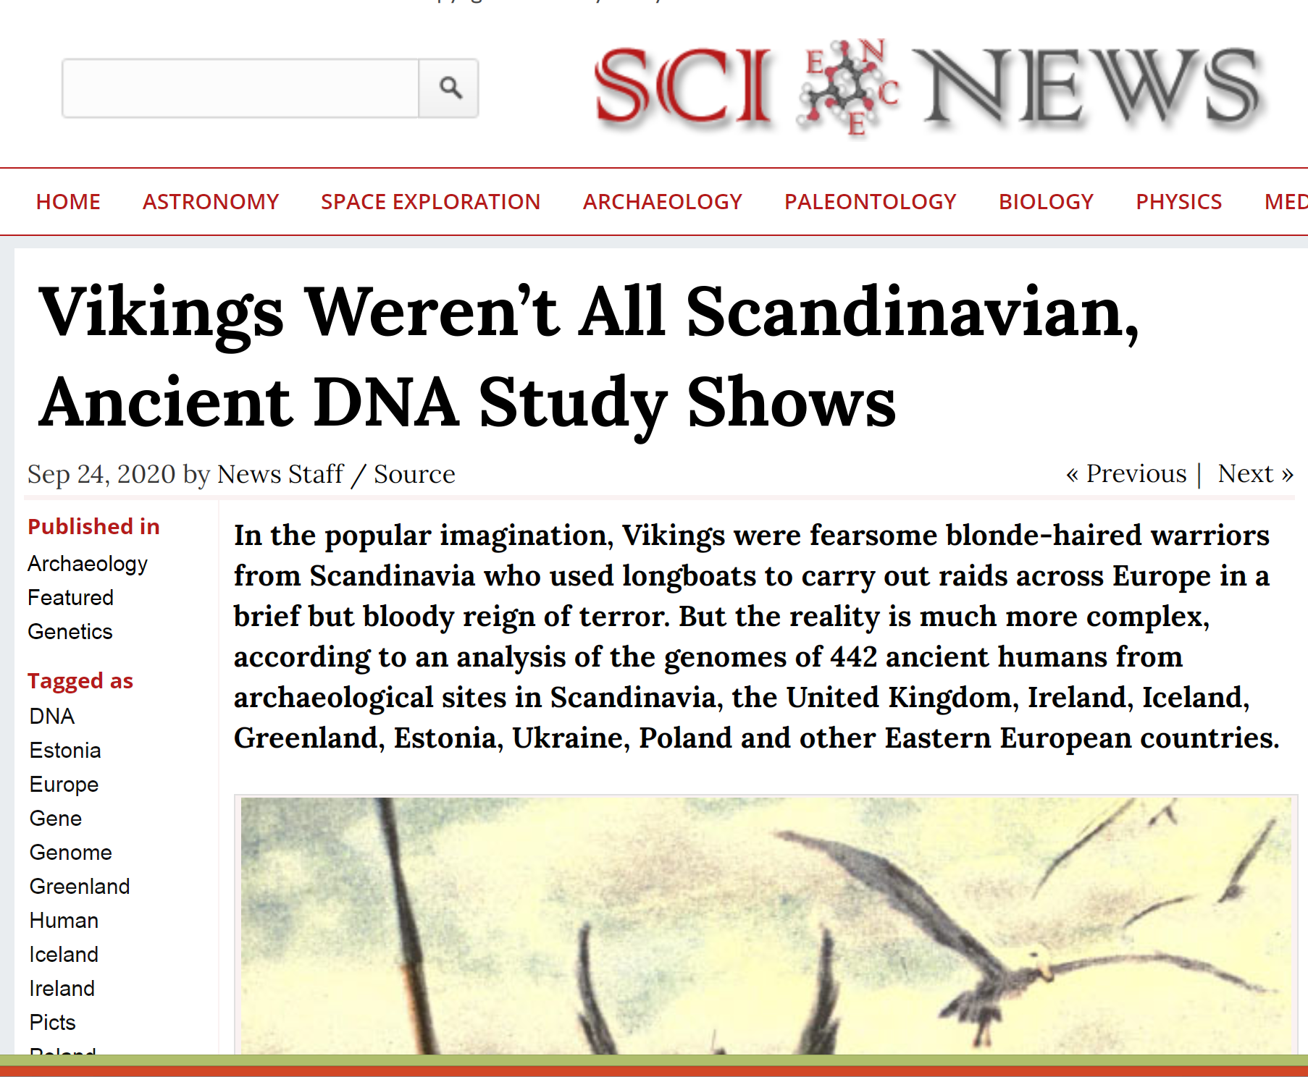
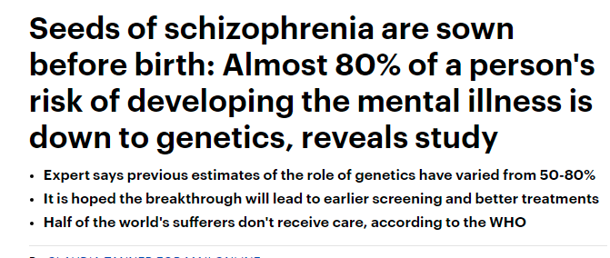
Notes:
Region of chromosome 3 that increases chance of Covid-19 may have come from Neanderthals

Slide 3
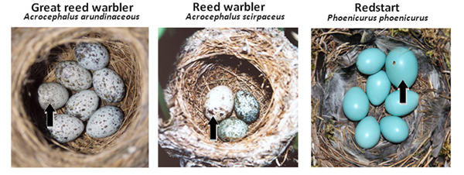
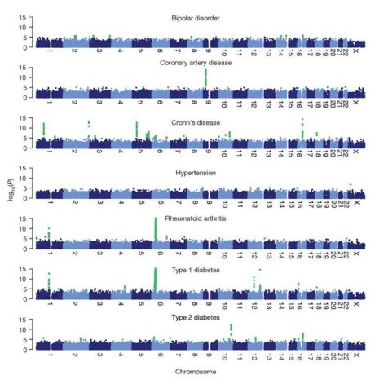
Population genetics
Figure 2: Nests with both host and parasitic common cuckoo eggs, illustrating near-perfect mimicry to the human eye. Black arrows identify cuckoo egg.
© 2010 Nature Education Courtesy of M. Honza, T. Grim, & C. Moskat. All rights reserved
All organisms differ – due to genetic variation
  Unrelated people differ more than relatives
  Still, people share characteristics
    Hair colour, eye colour, disease susceptibility, colour-blindness, blood group.....
(Wellcome Trust, 2010)
  These characteristics are all controlled by genetic variation
  Why, and how, do we expect mutations to be shared?
  The answer comes only by carefully considering models for genetic data, and their implications
  We need to look “back in time” to discover how mutations arise and spread in a population

Slide 4
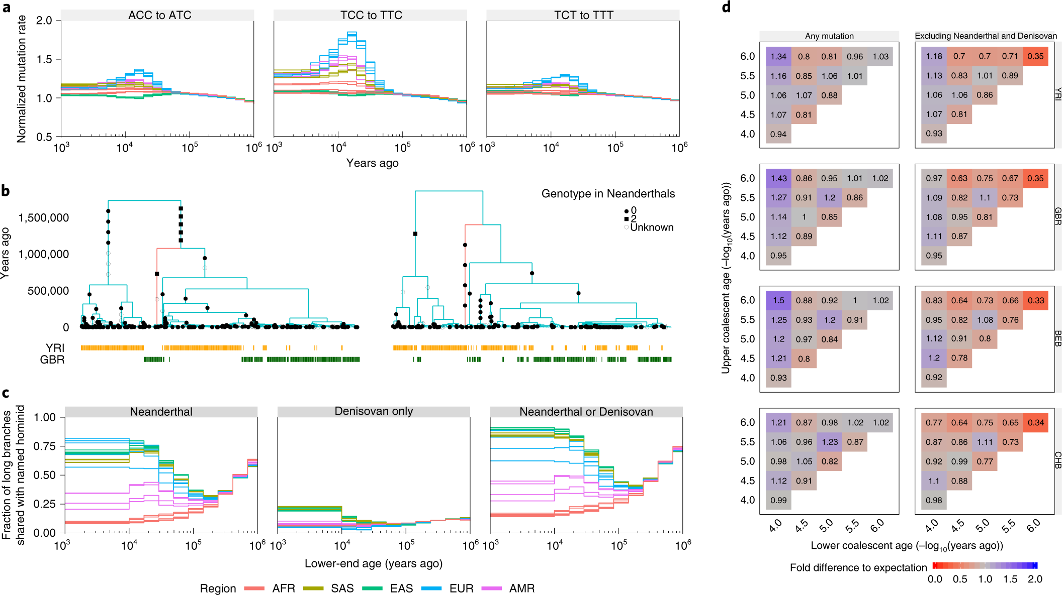
A human “genealogical tree”
Speidel et al. Nature Genetics 2019
Hammer et al.
(PNAS, 2000)
http://www.pnas.org/content/97/12/6769/F1.expansion.html
The axis is time in years, for a sample of 197 humans from the UK (GBR) and Nigeria (YRI). Tree built using DNA sequences, and is one of >50,000 made across the genome, for thousands of people.
Black squares/circles represent mutations seen in those samples
Red lineage matches DNA from the ancient Neanderthal, and is carried only by present-day GBR individuals
Shared characteristics come from shared mutations, and ancestors, often in the distant past
This tree and the times on it were inferred based on (an approximation to) the coalescent model
Computationally intensive inference (after Griffiths and Tavaré, 1994)
This model, its derivation, its properties and inference under the model are what we will look at first, using: stochastic processes, and simple graph theory.

Slide 5
Outline of the course
Two parts, of 8 lectures each
Part I (weeks 1-4)
  The “neutral model”
  Modelling genetic data
  Genealogical relationships
  Mutation patterns in populations
Part II (weeks 5-8)
  Extending the neutral model
  Recombination and “shuffling of genetic material”
  Natural selection
  Diffusion process models in genetics

Slide 6
The Wright-Fisher model
Suppose we are interested in a fragment of DNA, which might look like this:
AC..AAACGTTTAGCCGAT...GG
There are M (very similar) copies of this fragment in the whole population
M is often very large (>>1000)
For now, we view each fragment as an “object”, called a haplotype or sequence or gene
  Could be a few positions as shown above, or the whole Y-chromosome of 58,000,000 letters (bases)
Our task: model the history of these fragments in the population

Slide 7
The Wright-Fisher model
Fisher, Wright (1930-31)
“The simplest imaginable inheritance model”
Models the evolution of a population forward in time from one generation to the next
We then (approximately) go back in time
Constant size population of M haplotypes
Generations are discrete, and independent: in a generation, a complete new set of M haplotypes is created, and all M existing haplotypes die
Each of the M new haplotypes inherits their genetic material from the previous generation, choosing their “parent” independently and uniformly at random

Slide 8
A picture makes this clearer.
Formally, we form generation k+1 by choosing M “parents” at random in generation k with replacement
If parent of haplotype i in generation k+1 is Z_{i}
Some population members have 0 children, others more than 1 child:
Each haplotype chooses parent in previous generation
If haplotypes share a parent back in time, this is called a coalescence event
If we continue back in time, eventually a single parent is reached, the
Most Recent Common Ancestor (MRCA) :

Slide 9
A picture makes this clearer.
Formally, we form generation k+1 by choosing M “parents” at random in generation k with replacement
If parent of haplotype i in generation k+1 is Z_{i}
Some population members have 0 children, others more than 1 child:
Each haplotype chooses parent in previous generation
If haplotypes share a parent back in time, this is called a coalescence event
If we continue back in time, eventually a single parent is reached, the
Most Recent Common Ancestor (MRCA) :

Slide 10
A picture makes this clearer.
Formally, we form generation k+1 by choosing M “parents” at random in generation k with replacement
If parent of haplotype i in generation k+1 is Z_{i}
Some population members have 0 children, others more than 1 child:
Each haplotype chooses parent in previous generation
If haplotypes share a parent back in time, this is called a coalescence event
If we continue back in time, eventually a single parent is reached, the
Most Recent Common Ancestor (MRCA) :

Slide 11
A picture makes this clearer.
Formally, we form generation k+1 by choosing M “parents” at random in generation k with replacement
If parent of haplotype i in generation k+1 is Z_{i}
Some population members have 0 children, others more than 1 child:
Each haplotype chooses parent in previous generation
If haplotypes share a parent back in time, this is called a coalescence event
If we continue back in time, eventually a single parent is reached, the
Most Recent Common Ancestor (MRCA) :

Slide 12
A picture makes this clearer.
Formally, we form generation k+1 by choosing M “parents” at random in generation k with replacement
If parent of haplotype i in generation k+1 is Z_{i}
Some population members have 0 children, others more than 1 child:
Each haplotype chooses parent in previous generation
If haplotypes share a parent back in time, this is called a coalescence event
If we continue back in time, eventually a single parent is reached, the
Most Recent Common Ancestor (MRCA) :
We can examine historical relationships in a sample

Slide 13
Looking back in time
We seek to understand the distribution of the relationships among individuals (haplotypes) backward in time
  Why? Our DNA today is inherited from our ancestors
  Looking at only “real” ancestors means we don’t have to keep track of the entire population
Given there are i ancestral lineages at generation k+1, define p_{ij} as the probability there are j parents in generation k, j=1,2,...,i
Our “roadmap” is to proceed as follows:
  We characterise p_{ij}
  We assume M is large compared to i
  This means the population size is big compared to a sample we take from it
  In this setting, we use p_{ij} to approximate the distribution of the total time while exactly i ancestors remain
  We rescale this time, to measure it in natural units
  We show that as M becomes large, the whole (rescaled) backward process converges (beautifully) to a limit, called the coalescent

Slide 14
Example: two lineages
Suppose we have two ancestors in generation k+1. Then in generation k there are 1 or 2 ancestors:
Generations are independent
Define τ₂ as the time until a
coalescence event occurs, then
Obviously, this is geometric . What happens if M is very large? Note the mean time
If we measure time in units of M generations, the mean time is 1; independent of M. Proposition 1.0 shows that as M becomes large, this rescaled time has an exp(1) distribution.

Slide 15
Example: two lineages
Proposition 1.0
In a Wright-Fisher model with population size M, for a sample of size two taken from the population define τ₂ as the time back until a coalescence event occurs. Then setting T₂=τ₂/M to measure time in units of M generations, in the limit as M→∞, T₂ has an exponential distribution: T₂~exp(1).
Proof From above:
Note: by independence of generations, this extends to give the limiting time back until coalescence from any time point where we have two lineages.

Slide 16
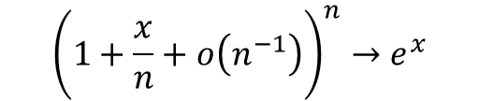
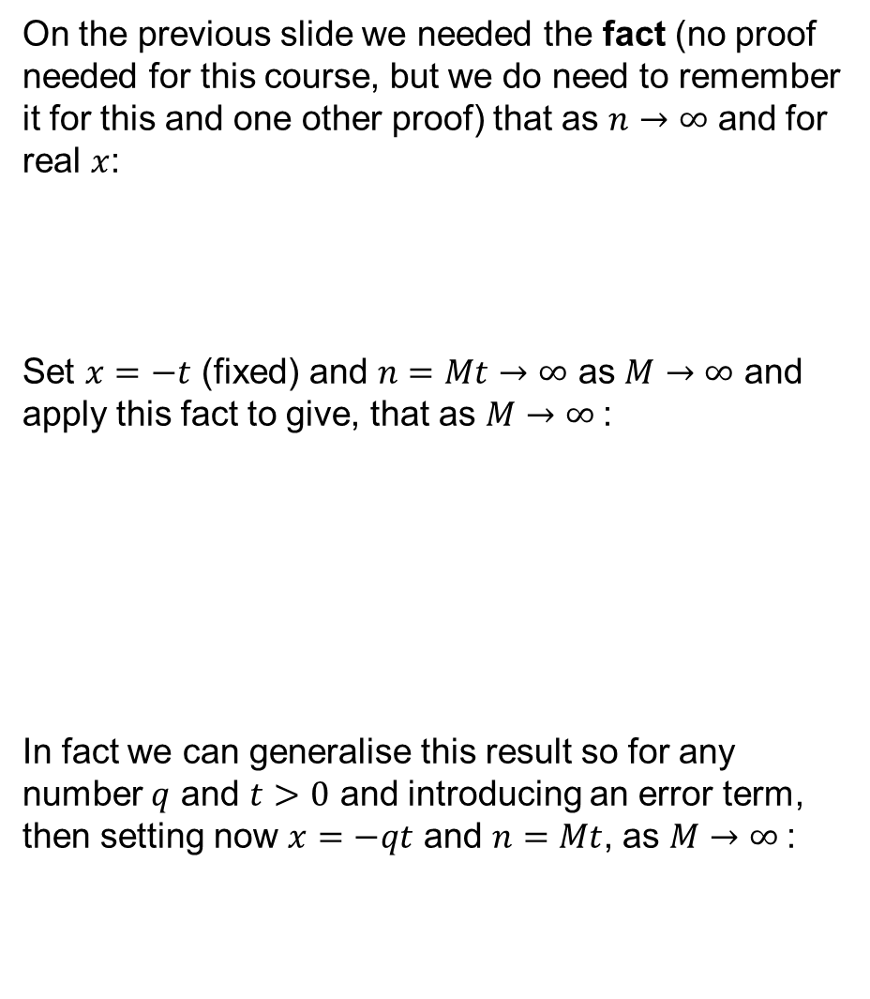
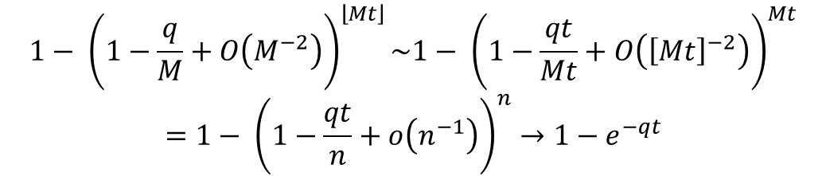
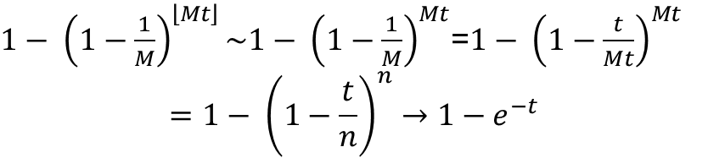
Additional note 1.1
On the previous slide we needed the fact (no proof needed for this course, but we do need to remember it for this and one other proof) that as $n→∞$ and for real $x$:
Set $x=−t$ (fixed) and $n=Mt→∞$ as $M→∞$ and apply this fact to give, that as $M→∞$:
In fact we can generalise this result so for any number $q$ and $t>0$ and introducing an error term, then setting now $x=−qt$ and $n=Mt$, as $M→∞$:
$${\left(1+\frac{x}{n}+o\left(n^{−1}\right)\right)}^{n}→e^{x}$$
${1− \left(1−\frac{1}{M}\right)}^{\left\lfloor Mt\right\rfloor }\sim {1− \left(1−\frac{1}{M}\right)}^{Mt}$=${1− \left(1−\frac{t}{Mt}\right)}^{Mt}$
$$={1− \left(1−\frac{t}{n}\right)}^{n}→1−e^{−t}$$
$${1− \left(1−\frac{q}{M}+O\left(M^{−2}\right)\right)}^{\left\lfloor Mt\right\rfloor }\sim {1− \left(1−\frac{qt}{Mt}+O\left({\left[Mt\right]}^{−2}\right)\right)}^{Mt}$$
$$={1− \left(1−\frac{qt}{n}+o\left(n^{−1}\right)\right)}^{n}→1−e^{−qt}$$

Slide 17

M and coalescence times in humans and other animals
In humans, it is known that “appropriate” values for M are surprisingly small. This is approximation is called the “effective population size”:
M ≈ 20,000 in Europe
M ≈ 19,000 in East Asia
M < 50,000 for all human populations, highest in Africa

Slide 18
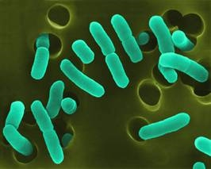
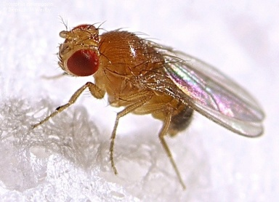
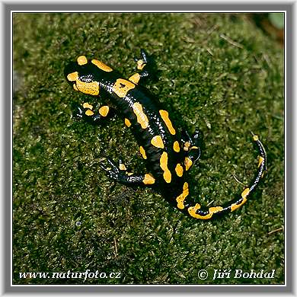
M and coalescence times in humans and other animals
The mean coalescence time for two lineages is
just in units of M generations, so if we
have G=28 years per generation, the average
ancestry depth for 2 human chromosomes is
1 ×M ×G in years
(20,000-50,000) × 28 =480,000-1,400,000 years
M varies widely across species (Charlesworth, Nature Reviews Genetics 2009):
25,000,000 for E.coli
2,000,000 for fruit fly
D. Melanogaster
<100 for Salamanders
(Funk et al. 1999)

Slide 19
A picture makes this clearer.
Formally, we form generation k+1 by choosing M “parents” at random in generation k with replacement
If parent of haplotype i in generation k+1 is Z_{i}
Some population members have 0 children, others more than 1 child:
Each haplotype chooses parent in previous generation
If haplotypes share a parent back in time, this is called a coalescence event
If we continue back in time, eventually a single parent is reached, the
Most Recent Common Ancestor (MRCA) :
We can examine historical relationships in a sample

Slide 20
Samples of size n
Suppose we are now following the history back in time of a sample of size n.
Measure time backwards and suppose τ generations back, there are ξ(τ) lineages remaining, ξ(0)=n
Generations are independent, so ξ(τ) behaves as a Markov process {ξ(τ), τ = 0, 1, . . .}
  In other words, given ξ(0) , ξ(1) ,..., ξ(τ) the distribution of ξ(τ+1) depends only on ξ(τ)
  The Markov process is homogeneous (does not vary across generations)
Our p_{ij}’s define the transition matrix P:
Question – given i lineages currently, what is the distribution of the time until the next coalescence event?
At the next coalescence event, how many lineages coalesce?

Slide 21
Samples of size n
  We consider the transition matrix:

Slide 22
Samples of size n
  What is the probability that more than one pair of lineages coalesce at the same time? This is
  Putting this together, supposing M is large and we have i lineages, in a single generation, to
  In words, asymptotically, only one pair of lineages can coalesce at a time – we have a binary tree.
  By symmetry, each time a coalescence occurs, all pairs of lineages are equally likely to coalesce
  To characterise the asymptotic distribution of trees, we then just need to derive the distribution of times between coalescence events. First, the answer.

Slide 23
The coalescent
(Kingman, Stochastic processes and their application, 1982)
As for the two lineage case, for the general case we will measure time in unit of M generations
We will show that the ancestral tree distribution in the Wright-Fisher model converges to the coalescent
This is one of the greatest discoveries in population genetics
The coalescent limit actually applies much more widely than just the W-F case (e.g., models with non-discrete gens)
The coalescent can be adapted to include many realistic features, some which we will see (mutation, population size changes, recombination) and others we will not (population splits and merges, migration......)
The coalescent is a distribution on binary trees:

Slide 24
The coalescent
(Kingman, Stochastic processes and their application, 1982)
Definition 1.1
The coalescent is a distribution on binary trees. Starting with n lineages, pairs of lineages coalesce backward in time until a single common ancestor is reached. Defining times T_{n}, T_{n-1},...,T₂ while n,n-1 ,..., 2 ancestors remain, the times T_{j} are independent and exponentially distributed:
At the time of coalescence from j to j-1 lineages, a pair of lineages is chosen at random from the j(j-1)/2 possibilities and coalesces.
The coalescent:
n=6

Slide 25
The coalescent limit
(Kingman, Stochastic processes and their application, 1982)
Proposition 1.2
In the Wright-Fisher model, as the population size M converges to infinity, if time is measured in units of M generations then the distribution on ancestral trees for a sample of n sequences converges to the coalescent.
Proof:
We previously showed that as M→∞, only one pair of lineages coalesce at a time, so the limiting tree is binary.
In the Wright-Fisher model, sequences choose parents at random, so obviously all pairs of lineages are equally likely to be the one to coalesce at a coalescence event
It remains to show only that the coalescent gives the correct distribution on the rescaled times T_{j} while j edges remain in the tree. Suppose a sample has j ancestors at some time in the past. Recall we showed the probability j ancestors remain in the previous generation is given by
If τ_{j} is the total time while j ancestors remain then
(independence)

Slide 26
The coalescent limit
(Kingman, Stochastic processes and their application, 1982)
Proposition 1.2
In the Wright-Fisher model, as the population size M converges to infinity, if time is measured in units of M generations then the distribution on ancestral trees for a sample of n sequences converges to the coalescent.
Proof (using the last result of additional note 1.1):
Now we rescale time in units of M generations. Set T_{j}=τ_{j}/M.

Slide 27
Properties of the coalescent
The coalescent is the limit of a range of models. From now on, we will work using only this model (until week 6).
The coalescent describes what evolutionary history looks like in populations
We will see it allows us to study variation, its main use.
It also allows us to understand population history
What properties does it predict?
We will ask two things in particular:
How deep are genealogies in time? How variable are these depths?
What is the distribution of tree shapes under the coalescent – e.g. are they approximately symmetrical?

Slide 28
Times in the coalescent
In the coalescent the number of lineages decreases from n to 1. The time at which the final coalescence takes place is called the time to the most recent common ancestor (TMRCA)
1.3 Mean and variance of the TMRCA
Immediately:

Slide 29
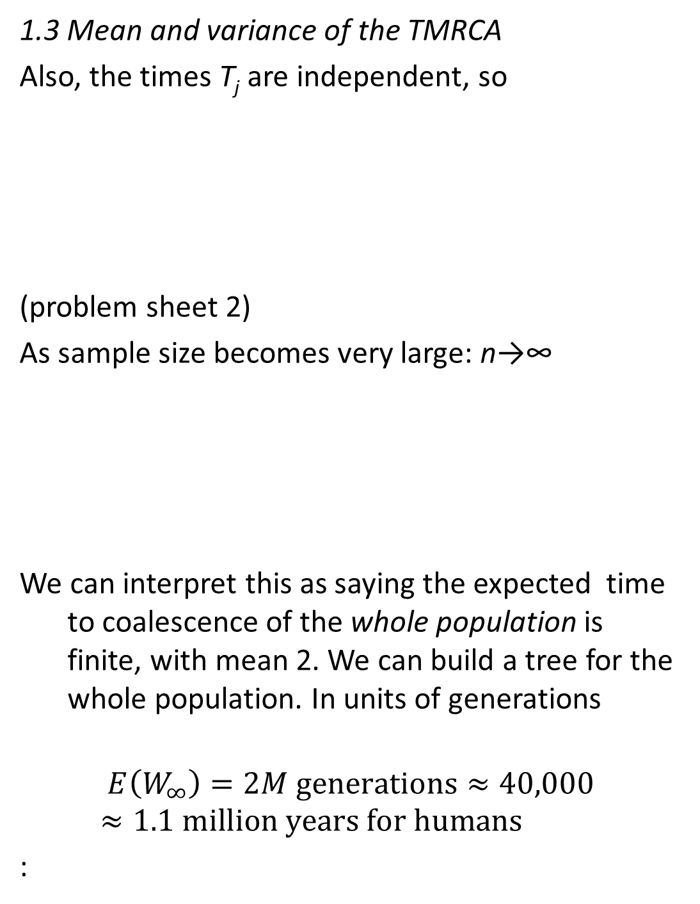
Times in the coalescent
1.3 Mean and variance of the TMRCA
Also, the times T_{j} are independent, so
(problem sheet 2)
As sample size becomes very large: n→∞
We can interpret this as saying the expected time to coalescence of the whole population is finite, with mean 2. We can build a tree for the whole population. In units of generations
$$E\left(W_{∞}\right)=2M \text{generations}≈40,000≈1.1 \text{million} \text{years} \text{for} \text{humans}$$
:

Slide 30
The “shape” of the coalescent
We could draw some tree shapes and ask “which is more likely”?
We need to be a bit more precise about what we mean. To do this, consider the number of descendants Z of each of the lineages when k ancestors remain
What is the distribution of Z? ANSWER: It is uniform on the possibilities
k=3
Z₁=1
Z₂=4
Z₃=2
n=7

Slide 31
The “shape” of the coalescent
Proposition 1.4
Suppose we have a sample of size n sequences, and that at some time back in the past, there are k sample ancestors. Then the number of descendants Z of each lineage has a uniform distribution on partitions of n :
Proof
We will use (backward) induction. The result is trivial for k=n. For the induction, suppose it is true for k≥m say. We only need to prove the hypothesis for k=m-1.
(If so, then the hypothesis is obviously true for k=2,....,n)
(1.4.1)

Slide 32
The “shape” of the coalescent
Proposition 1.4 proof ctd:
Clearly, when we have k lineages,
some pair of lineages coalesced to go from k+1 to k lineages
each of the k current lineages, say i, has probability 1/k of being the one that coalesced last (i.e. branches next)
Conditional on i branching next, we can write down a condition on the number of descendants of the k+1 lineages:
By the induction hypothesis, the probability of any configuration while k+1 ancestors remain is known, so using (iii):
Last, we need to sum over i according to (ii):
Z₁
Z₂
Z₃
.....Z_{i} ......
Z_{k-1}
Z_{k}
k
Z₁
Z₂
Z₃
Z_{i}’
Z_{i} -Z_{i}’
Z_{k-1}
Z_{k}
k+1

Slide 33
The “shape” of the coalescent
Proposition 1.4 proof ctd:
Example: how many copies of a mutation that occurs when k=2 are present in the sample?
The same as the number of descendants of one of the lineages when k=2 (Sheet 1, Question 5)
Conclusion: coalescent trees are not very symmetric

Slide 34
The “shape” of the coalescent
Note: We didn’t use times in the last proof – so Proposition 1.4 holds more generally, for any binary tree with random coalescence.
Corollary: Suppose there are k lineages and let Z be the number of descendants of one particular lineage. What is the distribution of Z?
Answer: This is just the marginal distribution of Z₁ in the previous proof. If Z₁=z, then the number of descendants of lineages 2,....,k must form a partition of n-z, into k-1 boxes. Thus

Slide 35
Simulating the coalescent
We’d like to apply all this theory to the real world!
In practice, we can usually only learn about history by looking at patterns of mutation in data
One thing we’d like to be able to do is simulate the coalescent to see if patterns “match up” with expectations
  If so, happy. If not, refine model or infer new model parameters
  Several free programs do this, e.g. makesamples, “ms” (R.R. Hudson), msprime (Jerome Kelleher)
  Simulations can directly enable statistical inference (ABC, machine learning)
How can we simulate the coalescent?
  We must simulate exponential times T_{n}, T_{n-1},..., T₂ between coalescence events (and record these)
  Then, at each coalescence event we must sample a random pair, record the answer, remove the original pair and replace with a new label to mark the coalesced pair
  Problem 4 on sheet 1

Slide 36
Comment
End of material needed for problem sheet 1!

Slide 37
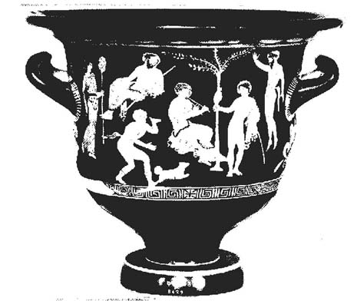
Urn models (supplementary!)
Instead of the whole coalescent tree, suppose we only wish to simulate a sample from the number of descendants of k lineages in a sample of size n
Urn models are a classical tool in probability theory
Also offer efficient simulation frameworks in genetics
In general, they are probability distributions on sets of coloured balls, sitting in an urn
We remove balls, and add balls, according to specified rules
  This makes simulation trivial
Balls often represent other things (e.g., lineages)
There’s a nice urn model representation of the distribution of descendants of k lineages
Uses the only thing we needed for our induction proof – when there are k lineages, each is equally likely to branch forward in time to give k+1 lineages. Gives an algorithm:
Classical Grecian urn
Classical probability urn

Slide 38
Urn model representation
Begin with k balls in an urn, of different colours
Take out a ball at random from those in the urn
Replace this ball with two of the same colour
Repeat 2 and 3 until there are n balls – then stop
k initial balls represent lineages, and balls sampled represent lineages that branch forward in time
Viewing it this way, our uniform distribution on partitions:
is just a classical result in probability theory.
k=4
(1.4.1)

Slide 39
2.0 Mutation
In practice, we can only really learn about population history using mutation patterns
  We can’t just look – slow pace of change in populations
  In any case, histories of interest are usually...historical
  We have to infer what happened by looking at the patterns of mutations in samples from the population
  This will be the subject of much of the rest of the course
We won’t need to know much about the details in some cases, but it helps to have an idea
What is mutation? DNA can change in a variety of ways:
Per gen.
probability
Event
TGCATTCCGTAGGC
~1.25-
2.5×10⁻⁸
Point mutation
TGCATTGCGTAGGC
TGCATT---TAGGC
Deletion
<10⁻⁸
TGCATTGCGGCGTAGGC
<10⁻⁸
Duplication
TGCTCATCATCATCAGC
TGCTCATCA------GC
≤5%
Tandem repeat variation
?
Selfish element insertion

Slide 40
Mutation in the coalescent
Distinct mutation events
In order to develop a model for genetic variation, we need to include mutation
We extend the coalescent to allow mutation
Recall edges represent ancestral lineages back in time
So: mutations in ancestors can be represented on the edges (as circles)
The descendants of a mutant edge inherit that mutation (unless another mutation reverses it)
Assume that with constant probability μ per generation, there is a mutation (e.g. μ =2.5×10⁻⁸).
In coalescent time, there are M μ mutations per unit time
We model this by taking a parameter θ=2M μ, fixed as M→∞
Mutations happen (in the limit as M→∞) continuously along edges, according to a Poisson process of rate θ/2 on each edge

Slide 41

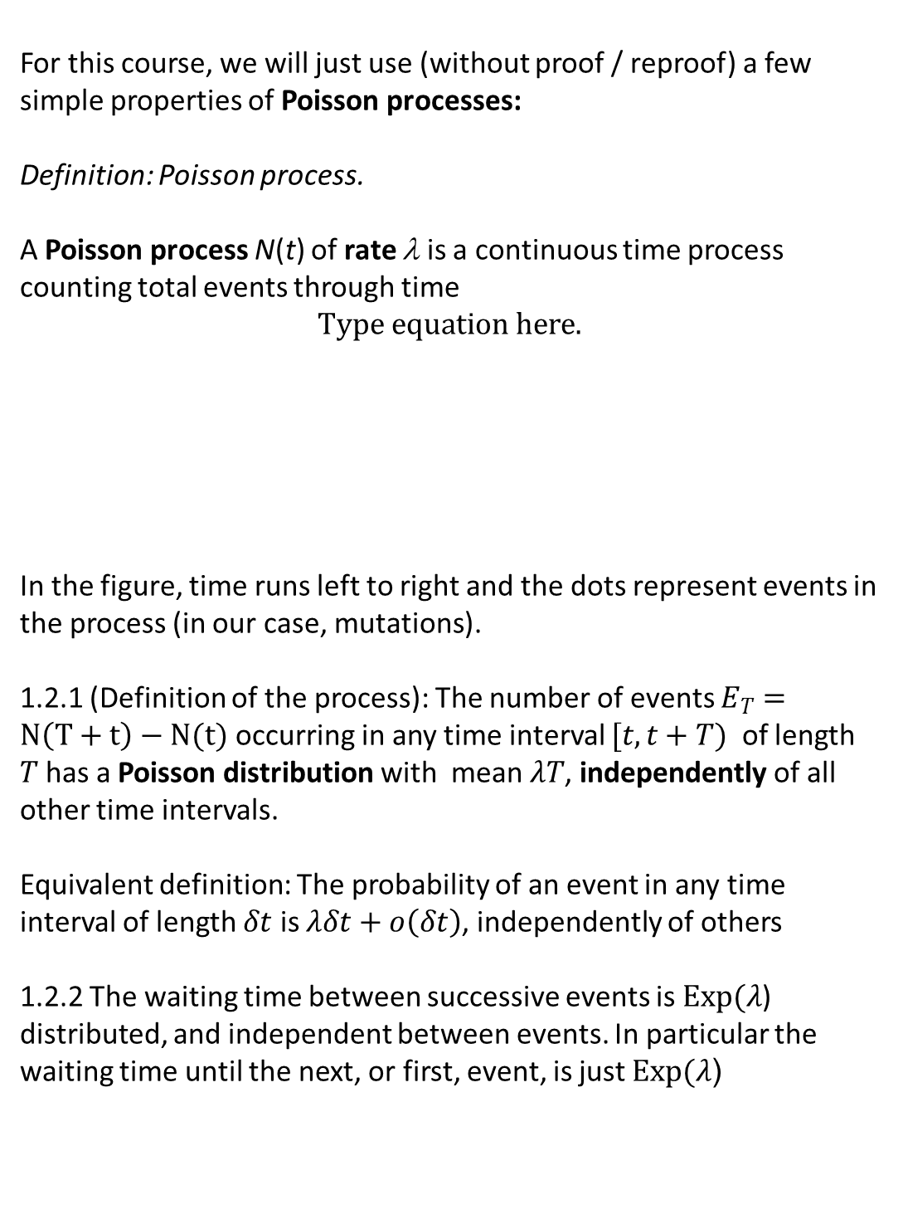





Facts 1.2: Poisson process properties we need
For this course, we will just use (without proof / reproof) a few simple properties of Poisson processes:
Definition: Poisson process.
A Poisson process N(t) of rate λ is a continuous time process counting total events through time
In the figure, time runs left to right and the dots represent events in the process (in our case, mutations).
1.2.1 (Definition of the process): The number of events $E_{T}=N\left(T+t\right)−N(t)$ occurring in any time interval $[t,t+T)$ of length $T$ has a Poisson distribution with mean $λT$, independently of all other time intervals.
Equivalent definition: The probability of an event in any time interval of length $δt$ is $λδt+o\left(δt\right)$, independently of others
1.2.2 The waiting time between successive events is $Exp(λ$) distributed, and independent between events. In particular the waiting time until the next, or first, event, is just $Exp(λ$)
$Exp⁡(λ$)
$$E_{T}=3$$
$$E_{T}\sim Poi\text{(}\text{lT}\text{)}$$
$$N\left(t\right)=1$$
$$N\left(T+t\right)=4$$
$$t$$
$$T$$
$$T+t$$

Slide 42
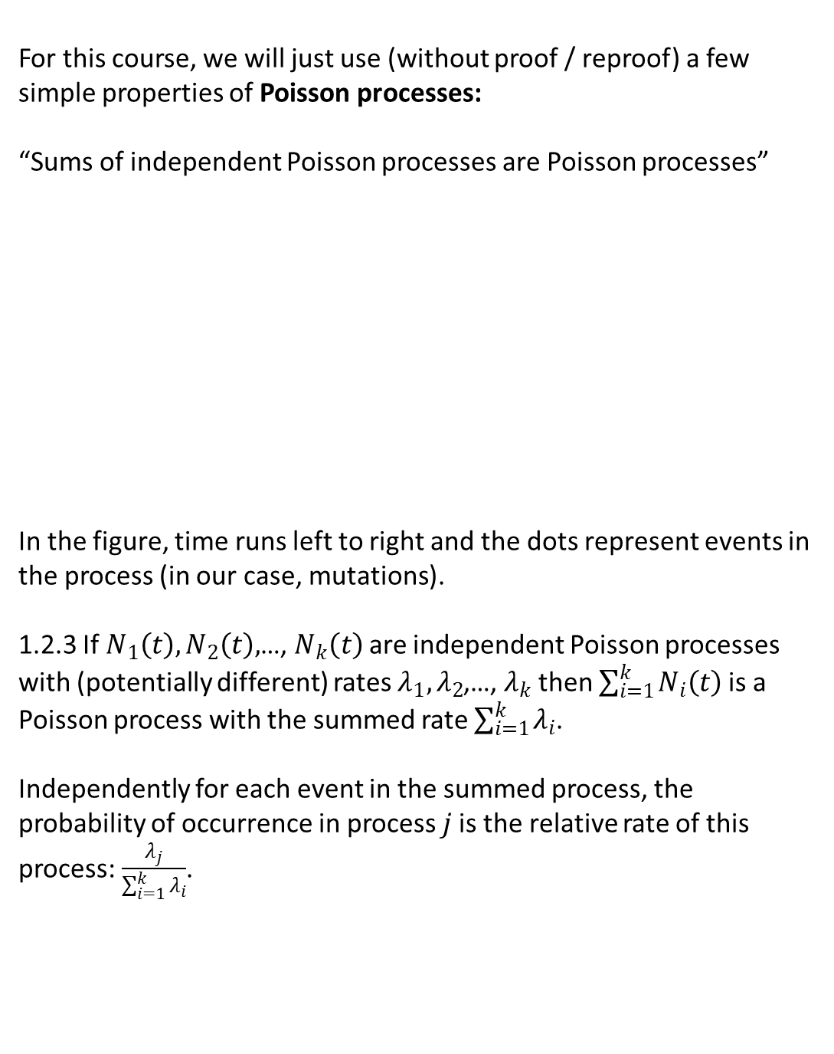




Facts 1.2: Poisson process properties we need
For this course, we will just use (without proof / reproof) a few simple properties of Poisson processes:
“Sums of independent Poisson processes are Poisson processes”
In the figure, time runs left to right and the dots represent events in the process (in our case, mutations).
1.2.3 If $N_{1}\left(t\right),N_{2}\left(t\right),$…, $N_{k}\left(t\right)$are independent Poisson processes with (potentially different) rates $λ_{1},λ_{2}$,…, $λ_{k}$ then $\sum_{i=1}^{k}{N_{i}\left(t\right)}$is a Poisson process with the summed rate $\sum_{i=1}^{k}{λ_{i}}$.
Independently for each event in the summed process, the probability of occurrence in process $j$is the relative rate of this process: $\frac{λ_{j}}{\sum_{i=1}^{k}{λ_{i}}}$.
$N_{1}(t)$, rate $λ_{1}$
$N_{2}(t)$, rate $λ_{2}$
$N_{1}(t)$+$N_{2}(t)$, rate ${λ_{1}\text{+}λ}_{2}$
$$P\left(red\right)=\frac{λ_{2}}{{λ_{1}\text{+}λ}_{2}}$$

Slide 43
Mutation in the coalescent
Poi(θ/2[Τ₆+Τ₅+Τ₄+Τ₃+Τ₂])
Τ₂
Τ₃
Poi(θ/2[Τ₆+Τ₅+Τ₄])
Poi(θ/2Τ₆)
Τ₆
Mutations happen (in the limit as M→∞) continuously along edges, according to a Poisson process of rate θ/2 on each edge
We may assume this for now, but we will later in the course derive a version of the coalescent with both mutation and coalescence events (and recombination, another kind of event)

Slide 44
The number of mutations
Define S= M_{n} + M_{n-1} +…+ M₂ to be the total number of mutations for a sample of size n, where M_{j} is the number of mutations while j ancestors.
Proposition 2.2
S has probability generating function
Further, for each j, M_{j} is independent, and has a geometric distribution with parameter p_{j}=(j-1)/(θ+j-1).
Proof.
By properties of Poisson processes (1.2.1), as total

Slide 45
The number of mutations
Proposition 2.2 proof ctd.
Thus
Further the jth term in this product corresponds to mutations in time T_{j}, so gives the p.g.f of M_{j}.

Slide 46
The number of mutations
Proposition 2.2 proof ctd.
We are essentially done, as this is the p.g.f of a geometric random variable. Indeed, setting
It is worth pointing out an interpretation here
Mutations happen independently for each epoch, while j ancestors
Consider mutations, or coalescences, “events”
While j ancestors remain, the probability the next event is a mutation is θ/(θ+j-1).
Otherwise, it is a coalescence with probability p_{j}= (j-1)/(θ+j-1),and we move to a state with j-1 ancestors

Slide 47
The mean/variance of mutation counts
Using the p.g.f of M_{j}
This immediately gives expectation and variance for the total number of mutations S:
This motivates Watterson’s estimator (1975) of θ:
This moment estimator is unbiased,
and consistent as n→∞

Slide 48
Example: Estimation of population size
As we have discussed, the coalescent is a limit under very general population assumptions
Time in units of M generations, where M is the “effective population size”
Estimation of M allows us to calibrate into years, to understand time depth.
I have given M estimates for humans
The data only give information directly on
θ=2M μ
To infer M or μ, we must know (or assume) the other. This idea is how M is generally estimated
Example 1 (Zhao et al., PNAS, 2000): In sequence data for 128 human chromosomes sampled worldwide, 75 variant sites were identified. If the mutation rate per DNA base per generation is 2.3 × 10⁻⁸, and 9,901 bases were sequenced, estimate the human effective population size

Slide 49
Example 1 (Zhao et al., PNAS, 2000): In sequence data for 128 human chromosomes sampled worldwide, 75 variant sites were identified. If the mutation rate per DNA base per generation is 2.3×10⁻⁸, and 9,901 bases were examined, estimate the human effective population size
Solution:
Watterson’s estimator:
Because we are given μ, we can estimate M:
This is a fairly typical value for a worldwide human sample. Finally...how does one get μ? Two ways:
  Chimpanzee genome comparisons
  Direct measurement in families
Note: Watterson’s estimator does not use all the information in data for θ.

Slide 50
Example: Time conditional on number of mutations
Genealogy depth is stochastically variable
Longer trees have more mutations (segregating sites) on average
The distribution of tree depth is altered given the number of segregating sites seen in data
Example 2 ( Dorit et al., Science, 1995): In sequence data for 38 human Y chromosomes sampled worldwide, no variant sites were identified at the ZFY locus. If the mutation rate at this gene per generation is 1.96 × 10⁻⁵, and generations last 20 years, derive an equation for the expected TMRCA conditional on this data and a population size N

Slide 51
Solution
If there is no variation in the sample, this means there are no mutation events in the coalescent history of the sample:
M_{n} = M_{n-1} =…= M₂=0
We can consider the times T_{j} while j ancestors remain. Recalling that over time T_{j}, the number of mutations on each of the j edges is independently Poisson with mean θ T_{j}/2, we have:
Thus conditional on M_{j}=0, T_{j} has the exponential distribution with a (reduced) mean

Slide 52
Solution continued
Finally, we can give the expected TMRCA (in years) conditional on no mutations:
Tabulating, we see our knowledge of no mutations (in 729 bp) does not have a huge effect:
Population size N | Mean TMRCA given no variation | Mean TMRCA unconditionally
2,500 | 92,000 | 97,000
5,000 | 173,000 | 195,000
10,000 | 313,000 | 389,000
Notes:
Expected number of mutations: only 0.411 or 0.824 or 1.647

Slide 53
Solution continued
Dorit et al. made an error, writing:
This led to strange conclusions – 95% CI of (0,800,000 years) and estimate of 270,000 years
This in turn led to a number of rapid critical responses, e.g. “Estimating the age of the common ancestor of men from the ZFY locus” Donnelly, Tavare, Balding and Griffiths, Science 1996
These data are actually compatible with a very wide range of times.
Humans are not very variable – on average 1 mutation every 1,000bp between 2 human chromosomes.

Slide 54
Supplement: distribution of number of mutations
We derived the p.g.f of the total number S of mutations. What is the full distribution of S?
We can apply the Gamma function property that for real z, Γ(z+1)=zΓ (z):

Slide 55
Variable size populations
Real populations don’t have constant size. Suppose the population size a time t in the past is N(t)=N(0)ν(t)
We need a “clock” – as before, measure time t in units of N(0) generations, N(0) now present day size
We will extend the coalescent to this setting
Recall that while j ancestors remain in a Wright-Fisher model, the probability, i.e. “rate” at which coalescence occurs is j(j-1)/2M per generation
In the new setting, the new per generation coalescence rate is
Measuring time in units of N(0) generations, while j ancestors, coalescence occurs at rate
A
B
C
Time
in
past

Slide 56
Variable size populations
Definition 2.3
The coalescent with variable population size is a distribution on binary trees. Starting with n lineages, randomly chosen pairs of lineages coalesce backward in time until a single common ancestor is reached. Suppose the relative population size at time t in the past is ν(t). While j edges remain at time t, coalescence events occur with instantaneous rate j(j-1)/2ν(t). Equivalently,
defining times T_{n}, T_{n-1},...,T₂ while n,n-1 ,..., 2 ancestors remain:
Comments
The standard coalescent case is ν(t)≡1
Equation 2.3.1 can be derived directly as the Wright-Fisher limit
Intuitively, in (2.3.1), if there are j lineages from time s to time t+s, the coalescence rate changes from j(j-1)/2ν(s) to j(j-1)/2ν(s+t)
This is the reason for the integral term, which “averages out” the coalescence rate
(2.3.1)

Slide 57
Variable size populations
How do we, e.g., simulate the coalescent with variable size?
The answer: we can use a coupling of times with the standard coalescent case.
Idea: we transform time into new units. Define
Proposition 2.3
In the variable population size coalescent with relative population size ν(t) at time t in the past, if time is rescaled by setting
then the transformed times S_{n}’, S_{n-1}’,...,S₂’ at which coalescence events occur are distributed according to the standard coalescent with constant size population
Comments
Note that transformed time increases more quickly when the population size is small
We invert the transformation to give each
To recover coalescence times, we take differences:
(coalescence times)

Slide 58
Variable size populations
Proposition 2.3
In the variable population size coalescent with relative population size ν(t) at time t in the past, if time is rescaled by setting
then the transformed times S_{n}’, S_{n-1}’,...,S₂’ at which coalescence events occur are distributed according to the standard coalescent with constant size population
Proof
Define the untransformed coalescence times S_{n}, S_{n-1},...,S₂. Restating (2.3.1) in terms of these times, we have:
Now it is clear the transformation is well defined, so for every positive t’=s_{j}’ there is a corresponding untransformed t=s_{j}. Further the transformation is increasing so

Slide 59
Variable size populations
Proposition 2.3
In the variable population size coalescent with relative population size ν(t) at time t in the past, if time is rescaled by setting
then the transformed times S_{n}’, S_{n-1}’,...,S₂’ at which coalescence events occur are distributed according to the standard coalescent with constant size population
Proof
Using this reverse transformation, for any
A key use of this idea is in simulation of histories under this model (and inference).

Slide 60
Simulation
Simulation under a variable size model can be accomplished simply, by the following:
Simulate coalescence times S_{n}’, S_{n-1}’,...,S₂’ under the neutral coalescent. Set S_{n+1}’=0, and then:
where the U_{j}’s are i.i.d U(0,1) random variables.
Convert these back to untransformed times S_{n}, S_{n-1},...,S₂ using
Given times, coalescence events are easy to sample, and mutation event counts have the usual Poisson distribution given tree times (note the mutation process in each ancestral lineage is independent of the population size).
In exponential expansion ν(t)=exp(-βt), so
Example
(sheet 2)

Slide 61
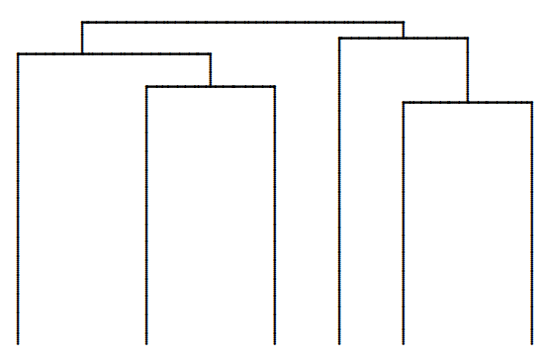
“Star-like” genealogies
Exponential expansion (or expansion generally) makes times relatively shorter in the top parts of the tree
Question: What is the effect of variation in population size on genetic variation data?
This could offer us a way to learn about population sizes in the distant past
To do that, we need to think about the frequency spectrum of mutations
We start by thinking about single mutations

Slide 62
3.0 The spread of diversity
The red mutation happens while there are k=4 lineages remaining.
It spreads and is seen in 3 of 6 sample members – the descendants of the lineage on which it occurs
More generally, the shape of the coalescence tree (Proposition 1.4 corollary) tells us that for any mutation that occurs while k ancestors remain from an initial sample size of n, the probability of b descendants is in general:

Slide 63
3.0 The spread of diversity
Almost always in practice, we only see diversity patterns.
We know n=6, b=3 but we do not know the number of lineages when the mutation occurred
What is the unconditional probability, q_{nb}, for a site which varies, that we observe b mutant copies in a sample of size n?
This is called the (expected) frequency spectrum of mutations
We can also ask, how old is a mutation seen in b of n copies?

Slide 64
The infinite-sites model
0.224
0.339
0.802
0.676
0.83
0.83
Not allowed!
0.965
0.543
0.02
Strictly, we need to make an assumption here.
If we see a mutation in some sample members but not others, we assume it is the result of one historical event, not e.g. two identical independent mutation events in different ancestors
Specifically – mutations always occur at a position never before mutant. This is called the infinitely-many-sites model
In this model, each individual site has a vanishingly small probability of mutating (but a region has a non-zero rate)
Without loss of generality, label mutations using independent uniform random variables in [0,1] (i.e. labels always unique)

Slide 65
The infinite-sites model
0.224
0.339
0.802
0.676
0.83
0.83
Not allowed!
0.965
0.543
0.02
1
2
3
4
5
6
0.02
0.224
0.339
0.543
0.676
0.802
0.965
0.83
1
2
3
4
5
6

Slide 66
3.0 The spread of diversity
The only thing we must work out is the probability a mutation observed in a sample occurs while k lineages, given only that the mutation segregates in the sample. Suppose the mutation occurs at x in [0,1].
We will not (for now) make any assumptions about times in the coalescent tree – so we are in the setting of the coalescent with variable population size
It helps to write the following
where I_{k}=1 if a mutation occurs in [x,x+δx) while k ancestors
That is, we consider the probability of exactly one mutation occurring, in a region containing x. The number of mutations in [x,x+δx) while k ancestors is Poisson with mean kT_{k}θδx/2, so

Slide 67
3.0 The spread of diversity
We can then sum over the distribution of T_{k} to give unconditionally:
As δx→0, at most one mutation occurs, so
and finally:

Slide 68
Example: constant size population
For a constant size population, recall:

Slide 69
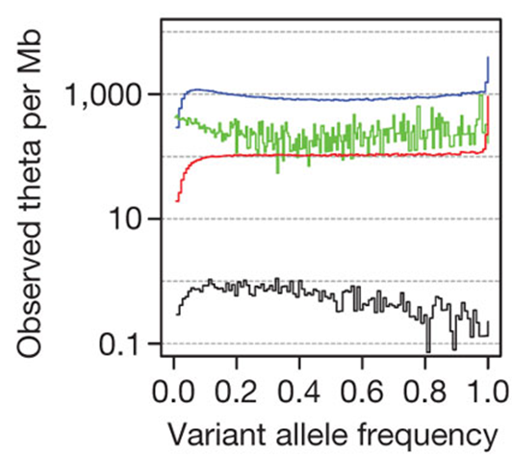
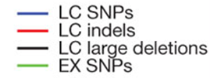
Real data vs. predictions
Our constant size model predicts there are more rare than common mutations:
What do we see for real populations? A remarkable match for a worldwide dataset with 6.5 million mutations:
“A map of human genetic variation from population level sequencing”
Nature Oct. 2010
Errors cluster at extreme frequencies

Slide 70
Supplement: how old is my mutation?
What is the expected age of a mutation if it is seen in b copies out of n?
Similarly to before, define an indicator variable equal to 1 if and only if a mutation in b copies of n occurs in a small interval [x,x+δx) containing x
Define ξ_{nb} as the age of such a mutation if it exists:
Note that the partition theorem for expectations yields:
Rearranging yields a formula for the required expectation, as δx becomes small:
(S1)

Slide 71
Supplement: how old is my mutation?
To go further, define I_{k}=1 as before if a mutation occurs in a small interval [x,x+δx) containing x while k ancestors. Also as before, condition on T=(T₂, T₂, …. T_{n}).
In equation (S1), note that partitioning over k, the (conditional) numerator and denominator may be written:
Now for any mutation occurring while k ancestors, its age is obviously uniform across the period while k ancestors, so then regardless of b:
where U is uniform on (0,1) and independent of the T_{i}’s. Taking expectations over T in (S2), then (S1) becomes as δx→0:
We can consider the constant size case again
(S2)

Slide 72
Example: constant size popn
The algebra missed out is tedious – it relies on certain combinatoric identities. For more (but not quite full) details, see RCG’s notes, linked to on the webpage
The age of a mutation at frequency x in the entire population
We just set and let n→∞, so b/n →x and
REFS:
Kimura and Ohta (1973)
Griffiths and Tavare (1998)
Wiuf and Donnelly (1999)

Slide 73
Practical implications
This theory is very important in practice!
  We have seen coalescence times, and hence the frequency spectrum, are affected by historical population size
  So – we can use the former to infer the latter (e.g. Adams and Hudson, Genetics 2004, Williamson et al. PNAS 2005)
  But there are always multiple possible histories exactly matching an observed spectrum (Myers, Fefferman and Patterson Theor. Pop. Biol. 2008)
The age of a mutation “should” fit with its frequency
  Selectively advantageous mutations can spread more quickly to high frequency
  Essentially all the approaches to find real selection, in humans and other species, use this idea
  Look for mutations which appear young, but are at high frequency

Slide 74
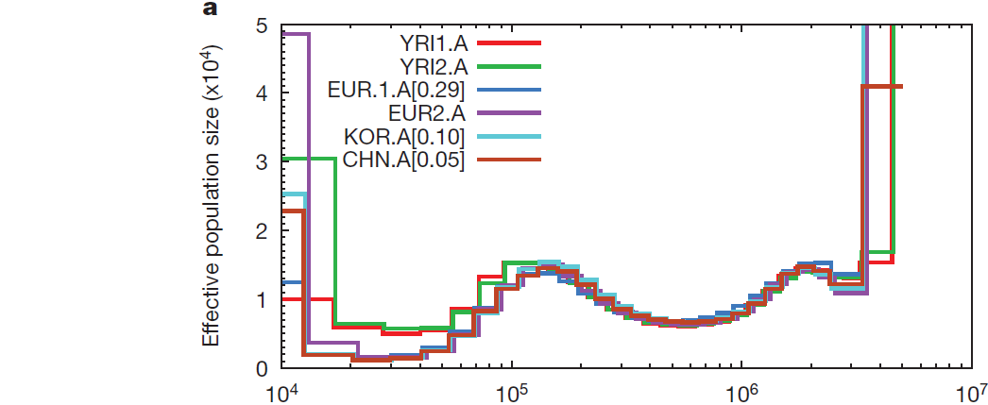
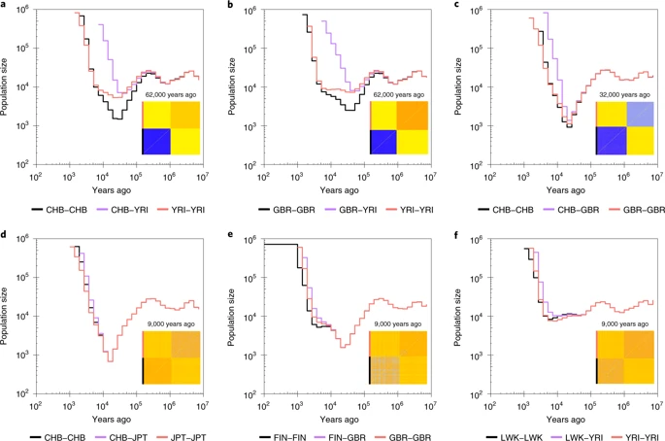
Estimates of ancient human population size
Li and Durbin
(Nature, 2011)
Speidel, Forest, Shi and Myers (Nature Genetics 2019)
Splits: About 80-120,000YBP (African, non-African)
About 40,000YBP (Europe, East Asia); ~10KYBP (Kenya, Nigeria)
<10,000YBP (China, Japan or UK, Finland)

Slide 75
4.0 The number of different types
K=5
We have talked about the number of segregating sites as a measure of diversity
Another natural measure of diversity is the number of distinct haplotypes K in a sample. How does this behave?
It is helpful to us to understand the distribution of this number
First, a definition. We say the infinitely-many-alleles model holds if every mutation makes a new type, never seen before in the population
Note, the infinitely-many-sites model is different from, but implies, infinitely-many-alleles

Slide 76
Following “non-mutant” lines
K=5
We will derive the mean, variance and p.g.f of K, the number of distinct alleles.
Looking back in time, view alleles (distinct types) as created at mutation events
To count alleles, we follow the tree, allowing coalescence events, until we see any mutation event – then we know that mutant ancestor passes on a unique type
We view this as a death process: lines “die”, through either mutation or coalescence
The last line to be lost always represents some final type

Slide 77
Following “non-mutant” lines
Proposition 4.1
Under the infinite-alleles model of mutation for the standard coalescent with mutation rate θ, the number of alleles K in a sample of size n can be written
where the indicator variables I_{j} are independent and
Proof
Consider following the coalescent history of the sample back in time, allowing lineages to coalesce, and “killing” lineages that mutate, until one lineage remains, at which point the process terminates.
The number of lineages clearly decreases monotonically from n to 1. While j lineages remain, we are tracing the history of a random sample of j lineages in the population, so coalescence occurs at rate j(j-1)/2 and mutation as a `1 process of total rate j θ /2.
Define I_{j}=1 if the jth lineage is lost by mutation and I_{j}=0 otherwise. The I_{j}’s are clearly independent. Denoting M_{j} to be the number of mutations while j ancestors in the coalescent:
From the previous discussion, each lineage lost by mutation adds one extra allele, and the last line remaining is an allele, so
(Propn 2.2)

Slide 78
Following “non-mutant” lines
As a corollary, it is straightforward to calculate the mean, variance and p.g.f of K:
By definition of the p.g.f:

Slide 79
Rates in the coalescent
A nice, powerful way to think of the coalescent is in terms of event rates (in Poisson processes). As usual we think backwards in time
While j lineages remain, the total coalescence rate is j(j-1)/2
We can think of this (by 1.2.3) as each pair of lineages coalescing, independently, at rate 1 (as a Poisson process)
Similarly, while j lineages, the total mutation rate is j θ /2, and on each lineage, mutation occurs independently at rate θ /2.
The rate at which some event occurs is the sum of all the rates, and the probability of each type of event can be obtained by the relative rate (by 1.2.3).
Example 1: In our death process representation of generating alleles, while j lineages (j>1):
Example 2: In the general coalescent, the probability the next event is a mutation on lineage i say is:

Slide 80
The distribution of K
We can get the distribution of the number of alleles by expanding the p.g.f:
We use an identity involving Stirling numbers of the first kind:
If we observe k alleles, we can obtain the m.l.e of the mutation rate.
Thus, the m.l.e. is the first moment estimator.

Slide 81
Large samples
We can deduce asymptotic behaviour for the number of alleles:
Asymptotically, almost all segregating sites uniquely define a new type in the sample and the number which do not is finite.

Slide 82
Supplement: Multiplicity of alleles
K=5
Suppose we are interested in the full distribution of the number of alleles and their frequencies in the sample.
We will construct an urn model, Hoppe’s urn, to sample from this.
Note: the death process shown above defines both the alleles (colours) and how many copies of each is in the sample
At coalescence events, pairs of lineages coalesce at random
All lineages are associated with colours
IDEA: We reverse time in the death process, so new types are “born”

Slide 83
Supplement: Multiplicity of alleles
K=5
Backward in time: While j of n lineages remain,
Forward in time, we start with 1 lineage, and while j:
At mutation events, we add a new “colour” to the tree
At lineage branches, the number of copies of chosen colour increases by 1

Slide 84
Supplement: Hoppe’s urn
We have effectively derived an urn representation
Represent alleles by balls of different colours in an urn, similarly to the “descendants” urn model we earlier introduced
We add an extra detail. There’s an extra “mutation” ball, of mass θ relative to the other balls with mass 1, and chosen with probability proportional to its mass
Definition (Hoppe’s urn model):
Hoppe’s urn model constructs a sample of allelic types and multiplicities for n haplotypes under the infinite-alleles model
Begin with a white and a coloured ball, of mass θ and 1.
While j non-white balls of mass 1, pull out one of the j+1 balls with probability proportional to its mass. If the white ball, replace in the urn and add in a single ball of a new colour. If a coloured ball, replace in the urn and add in an additional ball of the same colour
When there are n non-white balls, stop.
The number of different colours is the number of haplotypes in the sample, and the multiplicity of each colour the multiplicity of these types, summing to n.

Slide 85
Supplement: birth/death and Hoppe’s urn
Probability
1
2
v
3
v
1
4
2
5
3
4
5
6
6
v
The probabilities of numbered
events are identical in the urn and the genealogy

Slide 86
Ewen’s sampling formula
Define α(j) to be the number of types occurring at frequency j in the sample for j=1,2,..,n. Then if K=k:
Definition: Ewens’ sampling formula gives the probability of the sample configuration:
This can be proved inductively from the urn model
Note (n,K) is sufficient for θ

Slide 87
5.0 Gene trees!
Coalescent trees are not, in general, unique given variation data
We’d like a historical representation of a sample that is “well defined”, but reflects historical relationships among samples
The solution is to construct a gene tree
We again assume infinite-sites: each mutation occurs at a position never before mutant

Slide 88
Example gene tree
2
2
3
3
6
6
5
7
5
7
1
8
1
8
4
4
a
b
c
d
e
f
a
b
c
d
e
f
Coalescent tree
Gene tree
1
2
3
4
5
6
7
8
a
b
c
d
e
f
Data

Slide 89
5.0 Gene trees!
In a gene tree, vertices represent mutations
These are our information, from variation data
In general, the tree is not binary and a vertex can have any number of descendants
We often cluster identical sequences and allow multiplicities on the tips of the tree
Lineages below a mutation inherit the mutation
We will show
  The data and the gene tree are exactly equivalent
  One can check infinite-sites “compatibility” by deriving a necessary and sufficient condition for a gene tree to exist
To begin constructing a tree, think of our data as binary, with the mutant type denoted by 1, so the “ancestral” type is 0. We define an n×s incidence matrix S
  Each column represents a segregating site, with the total number of sites the number of mutations s in the sample history
  Each row represents a haplotype
Sequence\Site | 1 | 2 | 3 | 4 | 5 | 6 | 7 | 8
a | 0 | 1 | 0 | 1 | 1 | 0 | 0 | 0
b | 1 | 1 | 0 | 0 | 0 | 0 | 1 | 0
c | 1 | 1 | 0 | 0 | 0 | 0 | 1 | 0
d | 0 | 1 | 0 | 0 | 0 | 0 | 1 | 0
e | 0 | 1 | 0 | 0 | 0 | 0 | 0 | 1
f | 0 | 0 | 1 | 0 | 0 | 1 | 0 | 0

Slide 90
The incidence matrix
We say a sequence is ancestral if it perfectly matches the type of the ancestor
This corresponds to a row of zeros in the incidence matrix (mutation occur since the ancestor)
For site i, define the set of carriers of the mutation:
Sequence\Site | 1 | 2 | 3 | 4 | 5 | 6 | 7 | 8
a (1) | 0 | 1 | 0 | 1 | 1 | 0 | 0 | 0
b (2) | 1 | 1 | 0 | 0 | 0 | 0 | 1 | 0
c (3) | 1 | 1 | 0 | 0 | 0 | 0 | 1 | 0
d (4) | 0 | 1 | 0 | 0 | 0 | 0 | 1 | 0
e (5) | 0 | 1 | 0 | 0 | 0 | 0 | 0 | 1
f (6) | 0 | 0 | 1 | 0 | 0 | 1 | 0 | 0
Example above:
Notice that in these data, we have the following:

Slide 91
Ordering by inclusion
This pattern turns out to be general, and a powerful way to test the infinitely-many-sites assumption with the incidence matrix:
Proposition 5.1
If the infinitely-many-sites model holds, then defining O_{i} to be the set of individuals in a sample of size n carrying the ith mutation i=1,2,...,s, the O_{i}’s are ordered by inclusion:
Proof
Consider the coalescent tree for the sample. For any i and j, under infinite-sites the ith and jth mutations occur on tree edges. One of the following must occur: the mutation i edge is ancestral to the mutation j edge, the opposite occurs, or neither, respectively leading to the three conditions above.
j
i
i
i
j
j

Slide 92
Example
Is the following dataset, with sequence c ancestral, compatible with infinite-sites?
Sequence\Site | 1 | 2 | 3 | 4 | 5 | 6 | 7
a (1) | A | G | C | A | C | G | G
b (2) | C | T | T | A | T | A | C
c (3) | C | T | C | A | C | G | C
d (4) | A | T | C | A | T | G | G
e (5) | A | G | C | G | C | G | G
Incidence matrix, noting c is ancestral:
Sequence\Site | 1 | 2 | 3 | 4 | 5 | 6 | 7
a (1) | 1 | 1 | 0 | 0 | 0 | 0 | 1
b (2) | 0 | 0 | 1 | 0 | 1 | 1 | 0
c (3) | 0 | 0 | 0 | 0 | 0 | 0 | 0
d (4) | 1 | 0 | 0 | 0 | 1 | 0 | 1
e (5) | 1 | 1 | 0 | 1 | 0 | 0 | 1
 | 1 | 5
a (1) | 1 | 0
b (2) | 0 | 1
c (3) | 0 | 0
d (4) | 1 | 1
e (5) | 1 | 0
Check ordering by inclusion. Note that
Thus the data are not ordered by inclusion, so not compatible with infinite-sites
We will explore this idea more later on.
Note: removing sequence b would fix things.

Slide 93
Building gene trees
Suppose we take a gene tree and trace a “path to the root” for each sequence:
Denote the root as 0 and go backwards in time:
These “paths to root” are enough to build the gene tree, so equivalent to a gene tree
We need an algorithm to order mutations from variation data – Gusfield’s algorithm
2
8
3
4
5
9
1
6
7
f
b
c
a
e
d
g
a: 6 5 2 0
b: 1 5 2 0
c: 5 2 0
d: 7 9 4 8 2 0
e: 9 4 8 2 0
f: 3 2 0
g: 0

Slide 94
Gusfield’s algorithm
Gusfield, D.(1991). Efficient algorithms for inferring evolutionary trees. Networks, 21, 19–28.
Algorithm 5.2
For data compatible with the infinite-sites model, the following algorithm allows the generation of a gene tree based on an incidence matrix consisting of 0’s and 1’s, with the ancestral type always denoted by 0.
Reorder the columns, and column labels, by considering each column as a binary number, and ordering so the columns are decreasing. If duplicate columns occur, choose an arbitrary non-increasing column order.
For each sequence, construct a path to the root by reading from right to left in the corresponding row of the incidence matrix, recording mutation labels where 1’s occur in rows, and append 0 to this list.
Given paths back to the root, use these to draw the gene tree.

Slide 95
Example
A recent common ancestry for human Y chromosomes
Michael F. Hammer, Nature 1995. 16 sequences, 4 segregating sites seen.
1.
Sequence\Site | 1 | 2 | 3 | 4
a (7) | 0 | 0 | 0 | 0
b (1) | 0 | 1 | 0 | 0
c (3) | 1 | 0 | 0 | 0
d (4) | 1 | 0 | 1 | 1
e (1) | 1 | 0 | 0 | 1
Sequence\Site | 2 | 1 | 4 | 3
a (7) | 0 | 0 | 0 | 0
b (1) | 1 | 0 | 0 | 0
c (3) | 0 | 1 | 0 | 0
d (4) | 0 | 1 | 1 | 1
e (1) | 0 | 1 | 1 | 0
Incidence matrix
Reordered incidence matrix
2.
3.
a: 0
b: 2 0
c: 1 0
d: 3 4 1 0
e: 4 1 0
Paths to root
1
2
4
3
a:7
b:1
c:3
e:1
d:4
Gene tree

Slide 96
Variation data ↔ Gene tree
Proposition 5.3
Any variation dataset expressed in the form of an incidence matrix, where the sets of carriers of each mutation are ordered by inclusion, is equivalent to a gene tree.
Notes
This implies that ordering by inclusion is both necessary (proposition 5.1) and sufficient for a gene tree to exist, and hence for the data to be consistent with infinite-sites, so this is a complete check
Clearly a gene tree can be used to give an incidence matrix, which is automatically compatible with infinite-sites, so we must only prove a gene tree exists given an incidence matrix.
We will prove that Gusfield’s algorithm correctly produces such a gene tree.

Slide 97
Variation data ↔ Gene tree
Proof of proposition:
We prove Gusfield’s algorithm yields a set of paths to root giving a valid gene tree by induction on the number of sequences so far included in the gene tree. We consider constructing the tree, successively adding in sequences.
First, assume wlog all columns in the incidence matrix are unique (identical columns can be collapsed into one, if present)
After reordering the matrix, viewing each column as a binary number, note that
The first two algorithm steps obviously lead to a set of sequences of paths to root for each row in the incidence matrix. For the first sequence, we simply add the ordered sequence of mutations that sequence carries,
Suppose we have successfully added k-1 sequences to the gene tree.
There is obviously a gene tree:
For the induction hypothesis, suppose there are s mutations with a gene tree correctly produced from the first s-1 columns
After applying Gusfield’s algorithm, relative to s-1 sites, site s is inserted between some two columns.

Slide 98
Variation data ↔ Gene tree
Proof ctd:
We consider adding the kth sequence and Gusfield’s algorithm provides an ordered sequence of mutations this sequence carries:
Each of these mutations is carried by sequence k, so they are not disjoint, and as noted above:
Mutations on this list are either included on the current gene tree or not. Let be the first mutation already included in the current gene tree. Then form a new edge containing mutations and attach it to node , to include individual k in the gene tree:
We must now only show that the sequence of mutations on the pre-existing path from to the root is exactly
(5.1)

Slide 99
Variation data ↔ Gene tree
Proof ctd:
Note that by equation (5.1):
We know that some previous sequence m carries mutation and hence by (5.2), m must carry all the mutations
Because we successfully added sequence m in, according to the inductive hypothesis, these mutations all lie on the pre-constructed gene tree, and by (5.2) , since we add mutations in the order specified by Gusfield’s algorithm, they lie on the path upward from node to the root.
Conversely, any mutation q on the path from node up to the root is carried by sequence m, and since m carries , ordering by inclusion implies:
Thus sequence k also carries mutation q, so for some r>j
Thus, the mutations on the path from sequence k to the root are exactly those carried by sequence k, and we successfully add this additional sequence in
(5.2)

Slide 100
Bells and whistles
Mutations with identical patterns in the sample can be randomly permuted on the edge on which they occur
Identical sequences by convention share a single edge, labelled with multiplicity of the sequence
Unrooted trees do not assume we know the ancestral type at each mutation
  Given say A/G types at a site, we may not be able to infer which is ancestral
  An unrooted tree incorporates the set of all possible rooted trees.
2
2
8
4
3
4
3
9
5
9
5
8
1
6
7
1
6
7
f
b
c
a
e
d
g
f
b
c
a
e
d
g
8, 4, 9 all equivalent

Slide 101
Unrooted trees
An unrooted tree has sequences (instead of sites) as vertices. Some sequences are inferred in general
Edges between sequences contain the mutations separating them
A simple way to construct an unrooted tree from data is to construct a rooted tree, then “remove” root
In general, multiple (rooted) gene trees can give the same unrooted tree.
Straighten line to root, slide each mutation up from its vertex, and collapse edges with no mutations:
Example 1
g
b
1
2
2
4
c
.
f
3
5
3
9
6
4
5
8
1
6
a
9
7
f
b
c
a
e
d
g
8
Rooted
Unrooted
e
7
d

Slide 102
Unrooted trees
Example 1
g
g
2
2
4
4
3
9
3
5
9
5
8
8
1
6
7
1
6
7
f
b
c
a
e
d
g
f
b
c
a
e
d
f
b
c
a
e
d
Rooted tree
1. Slide mutations up
g
g
2
b
4
1
2
3
5
9
c
8
c
.
f
e
5
3
1
6
7
6
4
f
b
a
d
f
b
a
d
a
9
2. Remove terminal edges
8
e
7
d
3. Unrooted tree

Slide 103
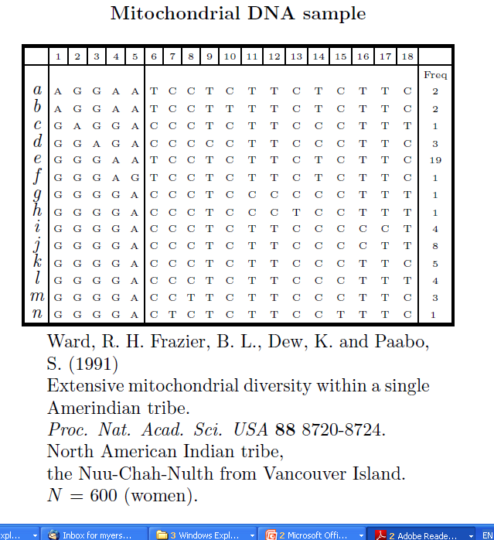
Example 2

Slide 104
Example 2
 | 1 | 2 | 3 | 4 | 5 | 6 | 7 | 8 | 9 | 10 | 11 | 12 | 13 | 14 | 15 | 16 | 17 | 18
a | 1 | 0 | 0 | 1 | 0 | 1 | 0 | 0 | 0 | 0 | 0 | 0 | 0 | 1 | 0 | 0 | 0 | 0
b | 1 | 0 | 0 | 1 | 0 | 1 | 0 | 0 | 0 | 1 | 0 | 0 | 0 | 1 | 0 | 0 | 0 | 0
c | 0 | 1 | 0 | 0 | 0 | 0 | 0 | 0 | 0 | 0 | 0 | 0 | 0 | 0 | 0 | 0 | 0 | 1
d | 0 | 0 | 1 | 0 | 0 | 0 | 0 | 0 | 1 | 0 | 0 | 0 | 0 | 0 | 0 | 0 | 0 | 0
e | 0 | 0 | 0 | 1 | 0 | 1 | 0 | 0 | 0 | 0 | 0 | 0 | 0 | 1 | 0 | 0 | 0 | 0
f | 0 | 0 | 0 | 1 | 1 | 1 | 0 | 0 | 0 | 0 | 0 | 0 | 0 | 1 | 0 | 0 | 0 | 0
g | 0 | 0 | 0 | 0 | 0 | 0 | 0 | 0 | 0 | 0 | 1 | 1 | 0 | 0 | 0 | 0 | 0 | 1
h | 0 | 0 | 0 | 0 | 0 | 0 | 0 | 0 | 0 | 0 | 1 | 1 | 1 | 0 | 0 | 0 | 0 | 1
i | 0 | 0 | 0 | 0 | 0 | 0 | 0 | 0 | 0 | 0 | 0 | 0 | 0 | 0 | 0 | 1 | 1 | 1
j | 0 | 0 | 0 | 0 | 0 | 0 | 0 | 0 | 0 | 0 | 0 | 0 | 0 | 0 | 0 | 1 | 0 | 1
k | 0 | 0 | 0 | 0 | 0 | 0 | 0 | 0 | 0 | 0 | 0 | 0 | 0 | 0 | 0 | 0 | 0 | 0
l | 0 | 0 | 0 | 0 | 0 | 0 | 0 | 0 | 0 | 0 | 0 | 0 | 0 | 0 | 0 | 0 | 0 | 1
m | 0 | 0 | 0 | 0 | 0 | 0 | 0 | 1 | 0 | 0 | 0 | 0 | 0 | 0 | 0 | 0 | 0 | 0
n | 0 | 0 | 0 | 0 | 0 | 0 | 1 | 0 | 0 | 0 | 0 | 0 | 0 | 0 | 1 | 0 | 0 | 0
A rooted tree can be constructed using Gusfield’s
algorithm from above incidence matrix (root is sequence k)

Slide 105
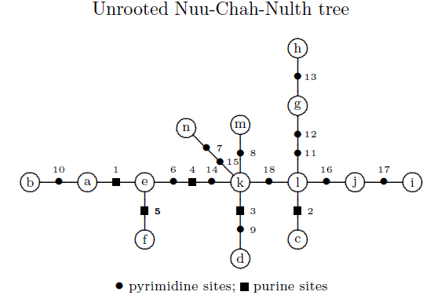
Example 2 continued
For these data I gave one possible choice of ancestral sequences leading to a rooted tree. We could have, e.g., used sequence l as ancestral
In general, for an unrooted tree containing s mutations, the total number of different sequences on edges (including tips) is s+1. Any of these could be the ancestor type.
Hence, there are s+1 possible rooted gene trees for a given unrooted tree, in this example 19 rooted gene trees.
Different root choices “toggle” 0 and 1 within columns

Slide 106
Conditions for trees
The infinite-sites model might be a strong assumption for some species
Given data, it is of interest to test this model
Suppose we know ancestral types
A natural approach is to ask if we can build a rooted gene tree, and hence a coalescent tree.
If so, we say our data is compatible with the infinite-sites model.
It is easy to prove the following:
Proposition 5.4
A variation dataset expressed in the form of an incidence matrix is compatible with the infinite-sites model if and only if the sets of carriers of each mutation are ordered by inclusion.
Proof
Proposition 5.1 shows necessity of ordering-by-inclusion. The proof of Gusfield’s algorithm (Proposition 5.3) shows we can build a gene tree whenever ordering-by-inclusion holds, which immediately implies sufficiency

Slide 107
Conditions for trees
There is a simple way to test this condition
Corollary 5.5
A variation dataset expressed in the form of an incidence matrix, where ancestral types are coded 0 and mutant types coded 1, is compatible with the infinite-sites model if and only if no pair of sites shows the pattern
in any 3 rows of the incidence matrix

Slide 108
Example revisited
Is the following dataset, with sequence c ancestral, compatible with infinite-sites?
Sequence\Site | 1 | 2 | 3 | 4 | 5 | 6 | 7
a (1) | A | G | C | A | C | G | G
b (2) | C | T | T | A | T | A | C
c (3) | C | T | C | A | C | G | C
d (4) | A | T | C | A | T | G | G
e (5) | A | G | C | G | C | G | G
Incidence matrix, noting c is ancestral:
Sequence\Site | 1 | 2 | 3 | 4 | 5 | 6 | 7
a (1) | 1 | 1 | 0 | 0 | 0 | 0 | 1
b (2) | 0 | 0 | 1 | 0 | 1 | 1 | 0
c (3) | 0 | 0 | 0 | 0 | 0 | 0 | 0
d (4) | 1 | 0 | 0 | 0 | 1 | 0 | 1
e (5) | 1 | 1 | 0 | 1 | 0 | 0 | 1
 | 1 | 5
a (1) | 1 | 0
b (2) | 0 | 1
c (3) | 0 | 0
d (4) | 1 | 1
e (5) | 1 | 0
Check new condition.
Note that for sites 1 and 5, rows 1, 2 and 4 respectively give the pattern
so these data are incompatible with infinite-sites.

Slide 109
Conditions for trees
Proof of Corollary.
Suppose we see this pattern at two sites, i and j say and some 3 rows.
Clearly
so ordering by inclusion does not hold, and the data are incompatible with infinite-sites, proving necessity.
Conversely if the data are incompatible with infinite sites, by the previous proposition for some pair of columns i, j ordering by inclusion does not hold:
For columns i and j and rows l, m, n in the incidence matrix:
so the pattern is seen, proving sufficiency

Slide 110
Unknown ancestral types
If we don’t know ancestral types, at each site we can’t tell who has the mutation, only who differs
The incidence matrix is defined up to “toggling” 0-1 status at each site
The compatibility question becomes whether it is possible to find a toggling to allow a rooted tree
Corollary 5.6
A variation dataset expressed in the form of an incidence matrix, where ancestral types are unknown, is compatible with the infinite-sites model if and only if no pair of sites shows the pattern
in any 4 rows of the incidence matrix

Slide 111
Conditions for trees
Proof of Corollary.
Suppose we see this pattern at two sites, i and j say and some 4 rows.
Clearly, toggling 0-1 status at either site this pattern remains. Therefore for any toggling the pattern
is seen, and the data are incompatible with a rooted tree and hence infinite-sites. This proves necessity.
For the converse, suppose there is no such pattern in any pair of columns. Toggle the matrix columns, so the first sequence is a row of zeros (i.e. pick this to be ancestral). Consider columns i and j. They do not show the pattern
Hence with this choice of ancestral sequence, there is a rooted gene tree by Corollary 5.3, giving sufficiency.
The first row of these two columns is by construction, so no other 3 rows have the pattern

Slide 112
Unknown ancestral types and unrooted trees
Any rooted tree can “build” an unrooted tree
An unrooted tree can “build” multiple rooted trees.
Notice an unrooted tree is invariant to 0-1 toggling of sites (because mutations on edges just show differences between sequences).
Thus:
  We can view an unrooted tree as the “ancestral type unknown” equivalent of a (rooted) gene tree
  The unrooted tree is unique even if ancestral types are unknown (up to permutation of equivalent mutations)
  Corollary 5.6 can be viewed as a condition on the existence of an unrooted tree:
g
b
1
2
c
5
.
4
3
f
6
a
9
8
Ancestral types known
Infinite sites
Rooted tree
No pattern
e
7
d
Ancestral types unknown
Infinite sites
Unrooted tree
No pattern

Slide 113
6.0 The probability of a dataset
Suppose we observe some variation data
What is its likelihood?
We can equivalently think of this as the probability of a gene tree
We only consider the infinite-sites case
We begin with a simple example

Slide 114
6.0 Example
Consider the following dataset, with 0 ancestral:
What is the likelihood of the data as a function of θ?
What is the distribution of the TMRCA conditional on θ and the data?
First, note there is only one possible coalescent tree:
Sequence\Site | 1 | 2
a | 1 | 1
b | 1 | 1
c | 0 | 0
Gene tree
Coalescent tree

Slide 115
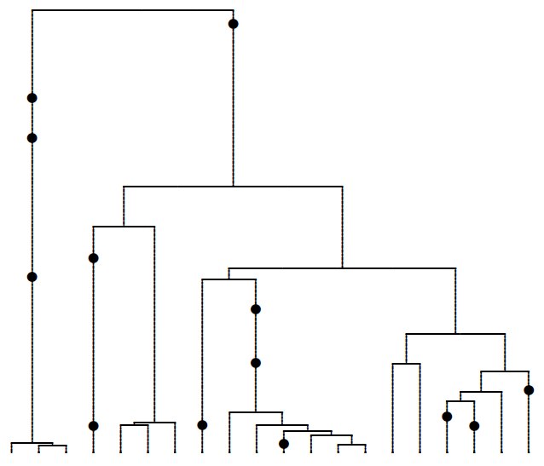
Coalescent histories
H_{f}
H_{f-1}
H_{j+1}
H_{j}
H₁
Define the history of a set of sequences:
where H_{j} defines what occurs at the jth mutation or coalescence event back in time, i.e. whether this event is a mutation or coalescence event, and which lineage(s) are involved. E.g. H_{j} shown above is a mutation on lineage 5.

Slide 116
Coalescent histories
Suppose there are k lineages remaining before the jth event. H_{j} is either a coalescence between two lineages m and n, C_{k}(m,n) or a mutation on some lineage m, M_{k} (m):
Different events are independent, conditional on the number of edges k remaining, due to property 1.2.3 of Poisson processes.
For the example:
(6.1)
H₁ is a coalescence, H₂ and H₃ are mutations, H₄ coales.

Slide 117
Times conditional on history
Having sampled the sample history, suppose there are k lineages remaining immediately before the jth event, H_{j.}. Events happen as a Poisson process, so times between events are independent and exponential (1.2.2):
For the example we can write the TMRCA as a sum of 4 independent exponentials. Then for example:
The oldest mutation has
expected age
E₄
E₃
E₂
E₁

Slide 118
Times given data
Alternatively - and equivalently - obtain the joint distribution directly:
This expression integrates to give the likelihood
Normalise to obtain the joint conditional density
The conditional density can be used to give the expected TMRCA:
Problem sheet 2 has another example
t₂
t₃

Slide 119
Complex datasets
For a general dataset, we have seen there is no unique coalescent tree.
We can still sum over histories
Given data D, define H(D) to be the (finite) set of possible histories producing the data
The likelihood is just:
To obtain expected ages of mutations, average over histories given data

Slide 120
Comment
End of material needed for problem sheet 2!

Slide 121
Review
In the introductory tree:
The model is the variable-size coalescent we derived
The parameters (population sizes) are fit to the data
The calibration into years uses 28 years per generation in the Wright-Fisher model
The structure of the coalescent tree depends on Gusfield’s algorithm – different positions have different trees
The ages of the mutations are obtained conditional on the data/tree, by “summing” over possible histories
The supplement describes one way this summing may be done efficiently, using importance sampling (IS).

Slide 122
Supplement: Importance sampling (IS)
There is typically an extremely large space of histories to sum...e.g. n!(n-1)!/2^{n} trees of n seqs.
Direct summation often computationally infeasible
Most histories have a negligible contribution to the likelihood
Can we add up the “important” terms?
We use a simple rearrangement to do this
For ANY distribution on histories with p.m.f Q, giving non-zero probabilities over H(D)
Q is called a proposal distribution

Slide 123
Importance sampling
ith importance weight
We simulate M different histories by sampling each independently using the proposal Q
Calculate the M corresponding importance weights and average
Each importance weight is an i.i.d random variable.
The previous page shows the mean of the importance weight distribution, sampling under Q, is the likelihood we seek.
The WLLN then implies the likelihood approximation above is exact as M→∞ for any valid proposal
How to pick a “good” proposal distribution, i.e. Q?
  We must be able to write down Q
  Picking a “good” proposal just means trying to make importance weights have low variance
  In the coalescent setting, that means picking “likely histories” given the data

Slide 124
Supplement: IS
ith importance weight
The best (known) scheme for infinite sites is due to Stephens and Donnelly (JRSS B, 2000).
They construct a proposal distribution Q on histories as follows.
Sample historical events successively back in time.
Before event j, identify the subset of n₀ lineages to whom the next event could occur
Choose one of these lineages uniformly at random: P(lineage i)=1/ n₀ and perform the (unique) corresponding mutation or coalescence event
Return to step 2 until common ancestor reached
[Note: no θ! The mutation rate comes in to the importance weights only through P.]

Slide 125
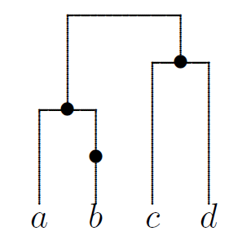
Example
Consider a dataset corresponding to the below gene tree, and sampling using Stephens’ and Donnelly’s Q.
For the first event in history
lineage b could mutate, or lineages c and d might coalesce.
Lineage a cannot be involved
Thus n₀=3 and
We choose a first event.
Next event chosen same way, until common ancestor reached
All lineages can have an event, n₀=4:
Continuing, for example:

Slide 126
Importance sampling example
Sequence\Site | 1
a | 0
b | 0
c | 1
4 possible histories:
History 1: C₃(1,2),M₂(3),C₂(1,2)
History 2: M₃(3),C₃(1,2),
C₂(1,2)
History 3: M₃(3),C₃(2,3),C₂(1,2)
History 4: M₃(3),C₃(1,3),C₂(1,2)
Initially: Sequence 1 or 2 can coalesce, sequence 3 can mutate so n₀=3. Any one of the 3 sequences can be chosen for the first event, with probability 1/3.

Slide 127
Importance sampling example
Sequence\Site | 1
a | 0
b | 0
c | 1
by equation (6.1)
History | Likelihood terms | Prob. | Importance weight
History 1 |  | 2/3
History 2 |  | 1/9
History 3 |  | 1/9
History 4 |  | 1/9
Likelihood |  | - | -
N.B. For any θ value, mean importance weight is true likelihood.
If θ=2, importance weights all identical – scheme is optimal

Slide 128
Glossary of terms used
Allele: a mutation or combination of mutations forming a distinct type in the population, within the region spanned by a haplotype
Coalescence event: An event back in time where two or more sequences share a single ancestor
Effective population size: the size of the Wright-Fisher population (which may change through time) that most accurately models evolutionary history in a real-world population
Frequency spectrum of mutations: the distribution of the number of mutant copies in a sample of size n over mutations segregating in a sample. We can define the observed frequency spectrum seen in an actual sample, the hypothetical expected frequency spectrum, and the population frequency spectrum (as n→∞).
Gene tree. A graphical object representing the history of a sample of sequences, with nodes representing mutations back in time. The type of the ancestor to the sequences corresponds to the top of the tree.
Haplotype (also loosely referred to as sequence, or sometimes gene): the DNA sequence of a region of DNA, sometimes interpreted to include only variable positions, and sometimes viewed as a binary sequence of 0’s and 1’s
Incidence matrix. A matrix of 0’s and 1’s representing variation in a sample when there are only two types present at each segregating site. Rows represent sequences, and columns correspond to sites. If known, the ancestral type is often represented by 0 at each site.
Infinitely-many-sites model. The idea that mutation is rare (true in many species) so that mutations always hit different positions in the genome. This means if a segregating site is observed, it is always the result of a single historical mutation, never two independent, identical mutations at the same position.
Infinitely-many-alleles model. The related idea that mutations always create new alleles in the population. Thus if two haplotypes are identical, there are no mutations on the history between them before their MRCA. NB – the infinitely-many-sites model implies the infinitely-many-alleles model, so is a special case (under infinite-sites, each mutation is new in the population so trivially defines a new allele).
Most recent common ancestor (MRCA): the first ancestor in the history of a sample of n sequences who all n sequences are descended from.

Slide 129
Glossary of terms used
Root sequence: A sequence whose type is identical to that of the MRCA. In the binary infinite-sites model representation of variation, this corresponds to a sequence whose type is all zeros and can be used to define which type is represented as 0, which as 1, at each mutation.
Segregating site: a mutation seen in some, but not all, members of a sample of size n
Time to the most recent common ancestor (TMRCA): the time back at which the MRCA lived
Unrooted tree. A graphical object representing the relationships among a sample of sequences, with nodes representing sequences and mutations along edges. The type of the ancestor to the sequences does not need to be known.
Watterson’s estimator: A moment-based estimator of the population scaled mutation rate, based on the number of observed segregating sites in a sample of size n.

